Slide 1

Reduce, Reuse, Recycle!

Slide 2


What IS Reduce, Reuse, Recycle?
Reduce: Using less
  How can YOU use less?
Resue: Using items more than once
  What items can you use again?
Recycle: Making new items out of old items
  What do we recycle?
Notes:
Reduce: use the blank sides of homework paper, turn off the water when not using, turn off lights
Reuse: sacks, boxes, silverware/plates
Recycle: paper, milk jugs, bottles, cans (steel and aluminum)

Slide 3
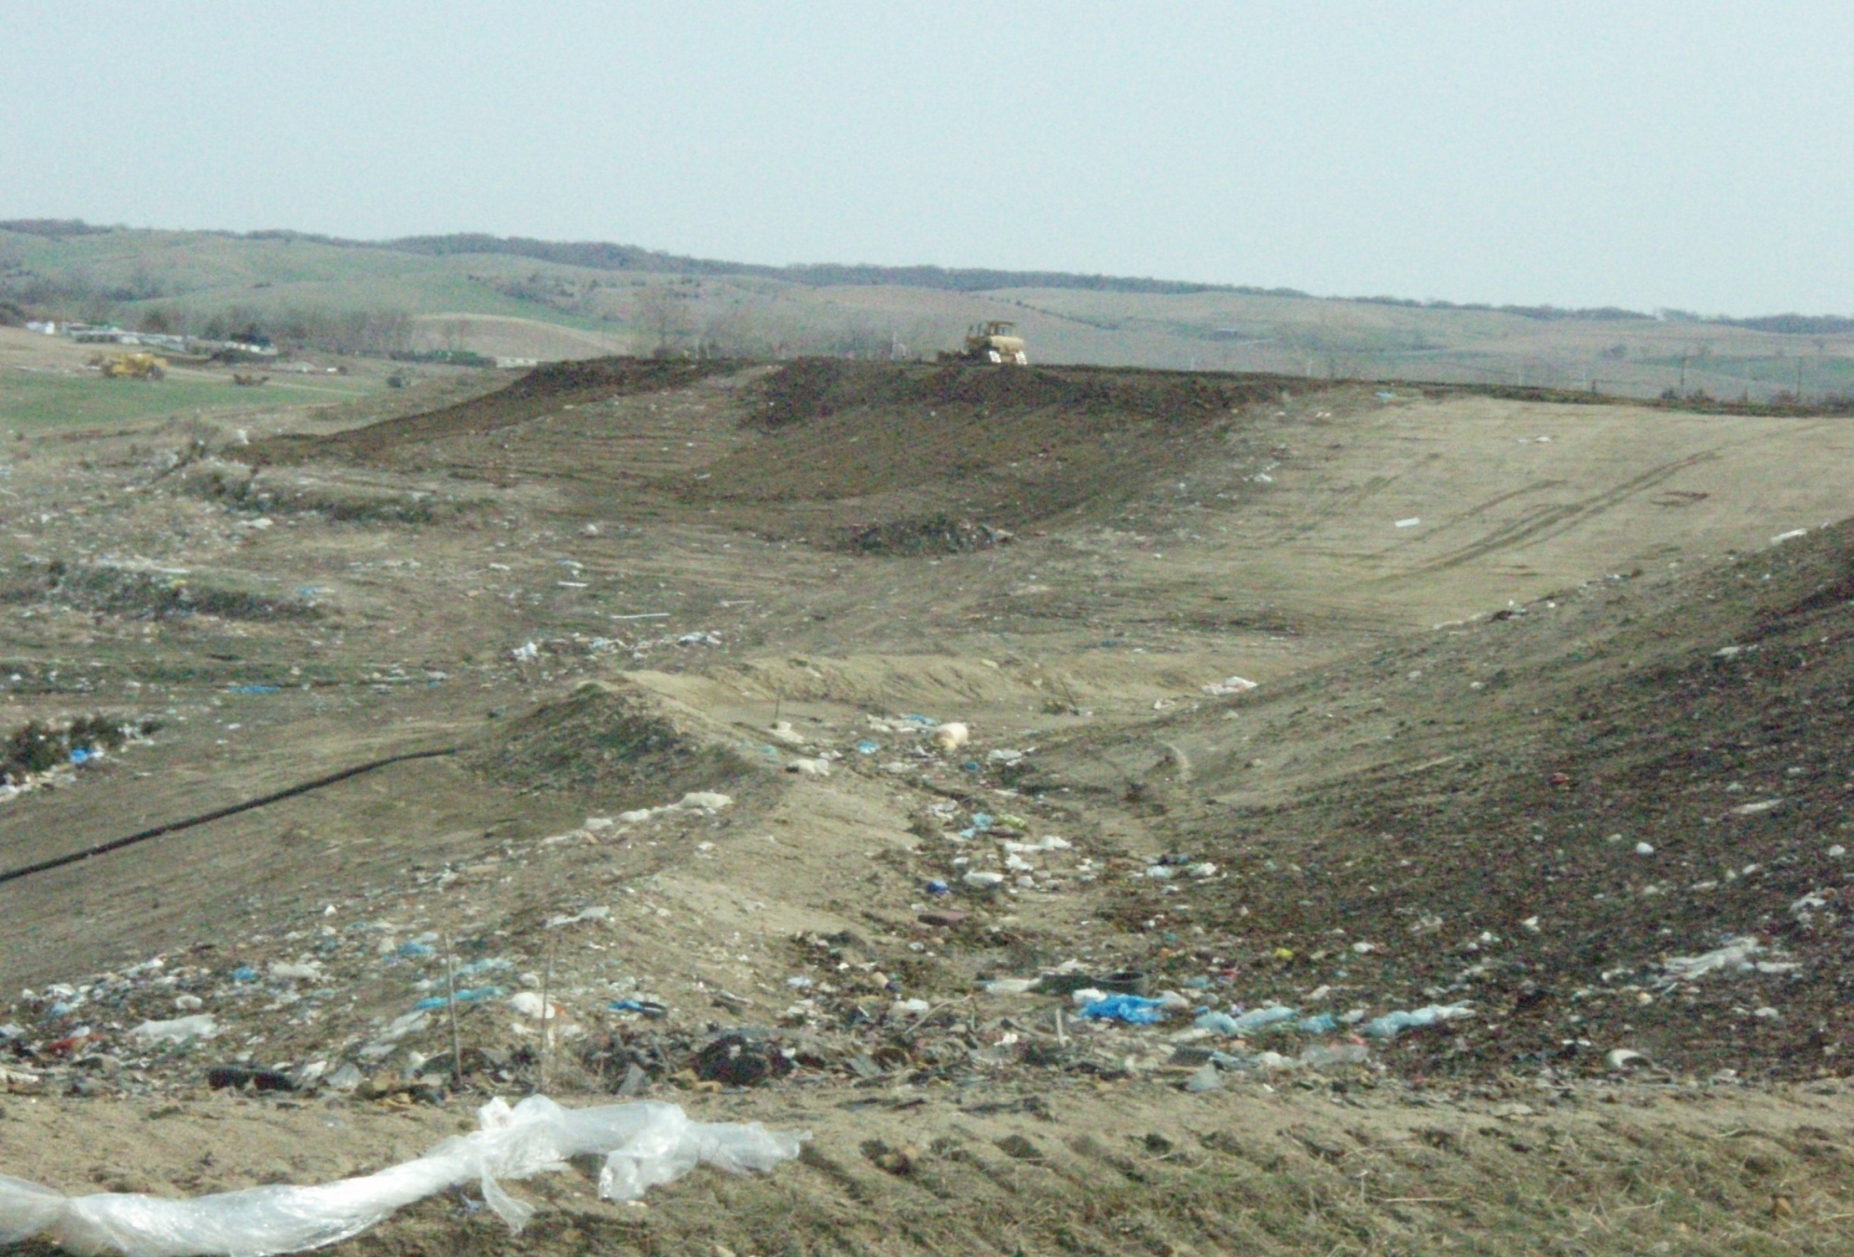
Why should we Reduce, Reuse, Recycle?
Because of TRASH mountains like this one!
Notes:
Explain landfill site, process

Slide 4
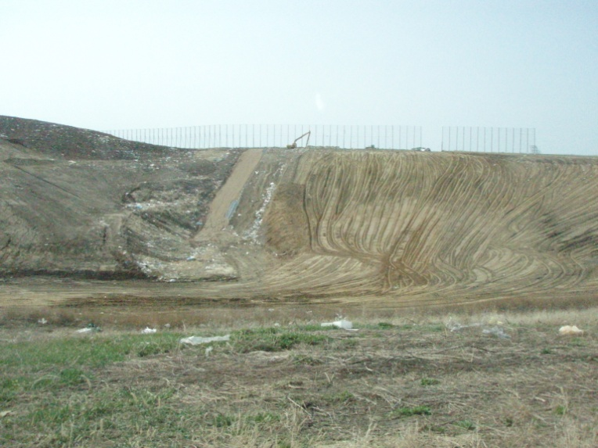
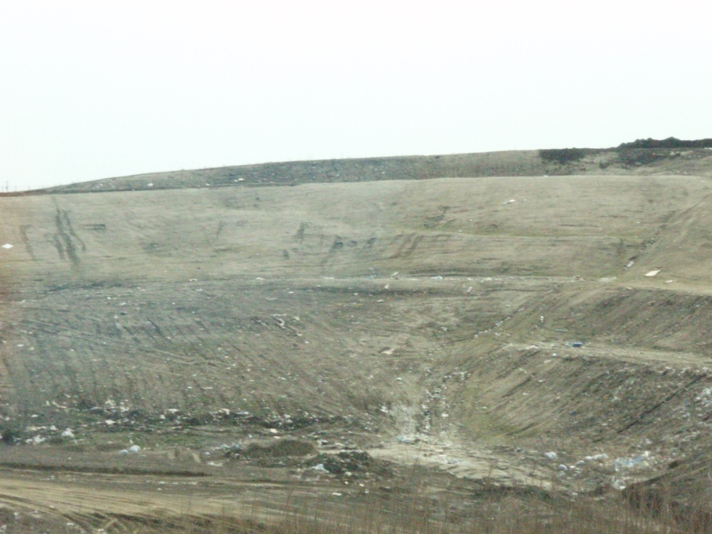
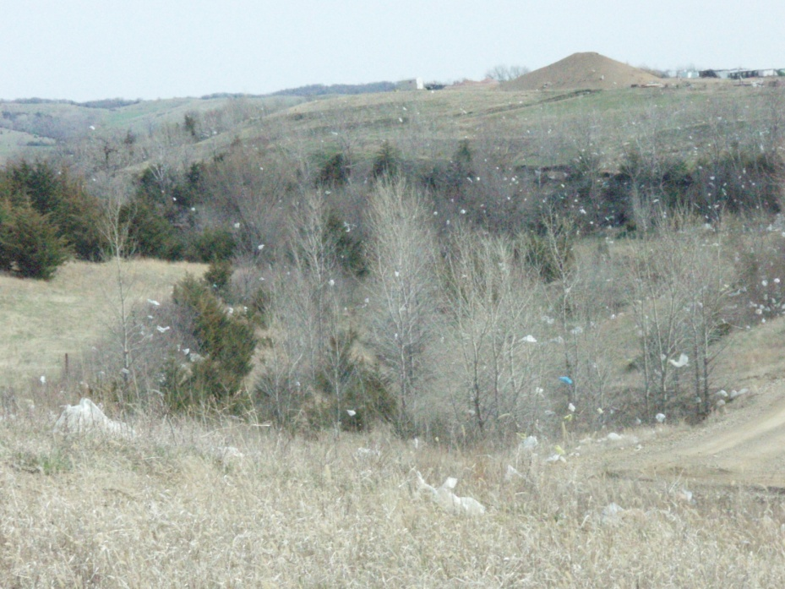
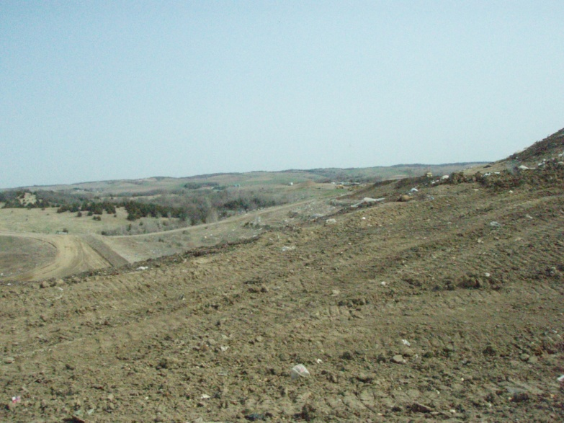
Trash everywhere!
900,000 pounds of trash are laid here EACH DAY!
  That’s 75 male elephants!
  That’s 150 pick-up trucks!

Slide 5
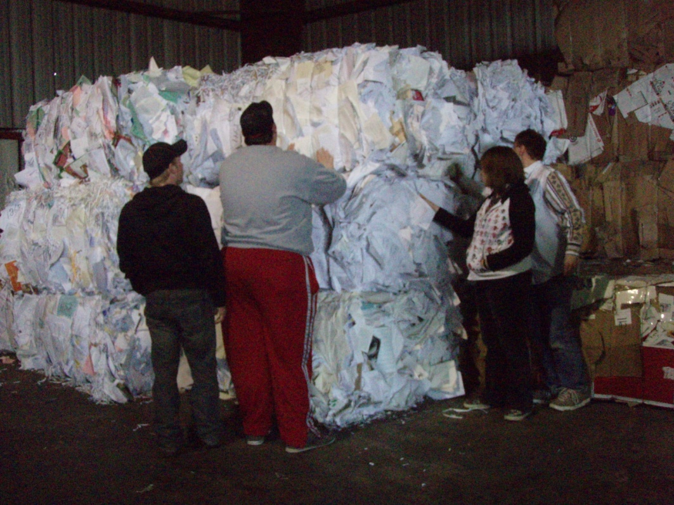
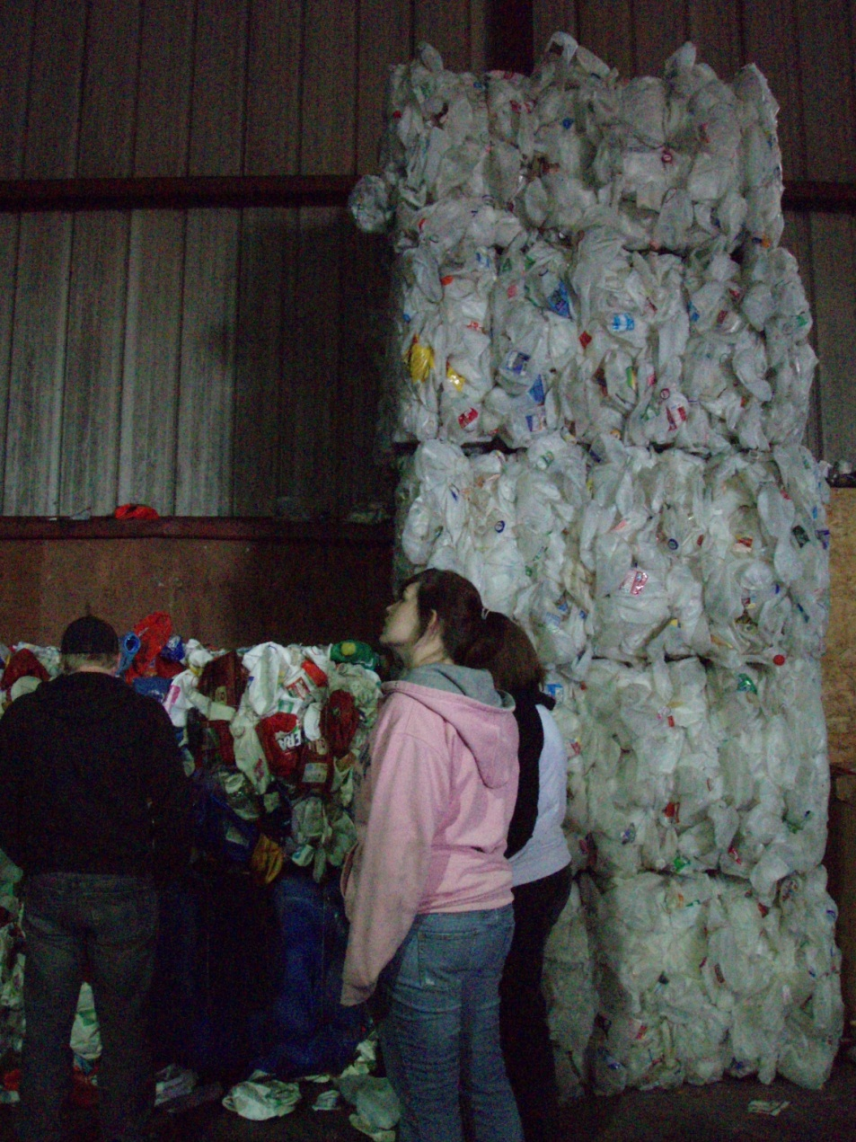
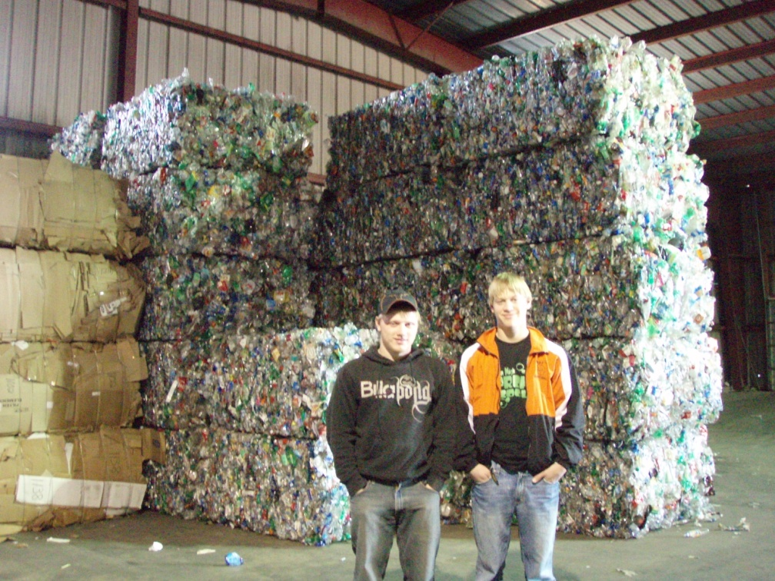
How does
Recycling work?
Plastic jugs—each bale weighs hundreds of pounds!
Paper bales—over 2,000 pounds each!
Cans!
Notes:
40-50% of wastes thrown in a landfill may be recycled
Tell process of baling, selling, making new products

Slide 6
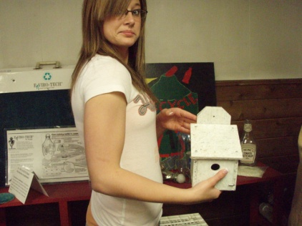
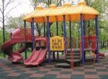
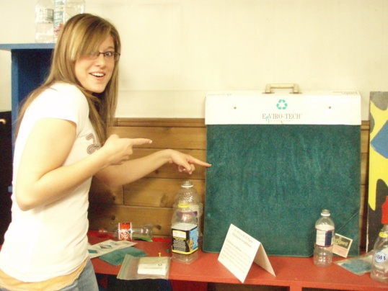
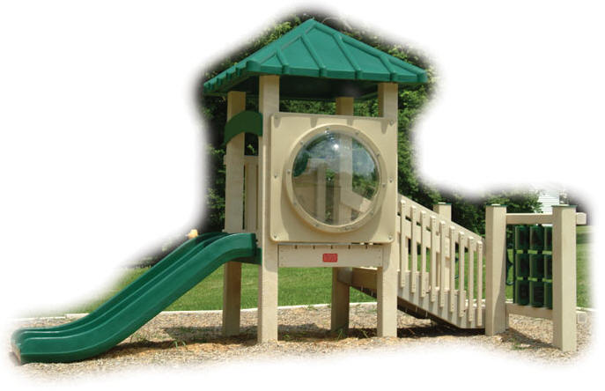
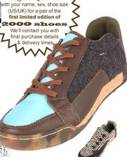
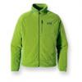
What new products can be made?
Birdhouses
Carpets
Playground “floors”
Shoes
Jackets
Playground equipment
And much, much more!!
Notes:
March-May challenge with plastic bottles

Slide 7
What can YOU do to help?
1st—REDUCE
  Use less if you can!
2nd —REUSE
  Find another job for it before you throw it away!
3rd—RECYCLE
  Don’t throw it in the trash,
  bring it downtown so it can be
  made into something else!

Slide 8
