Slide 1
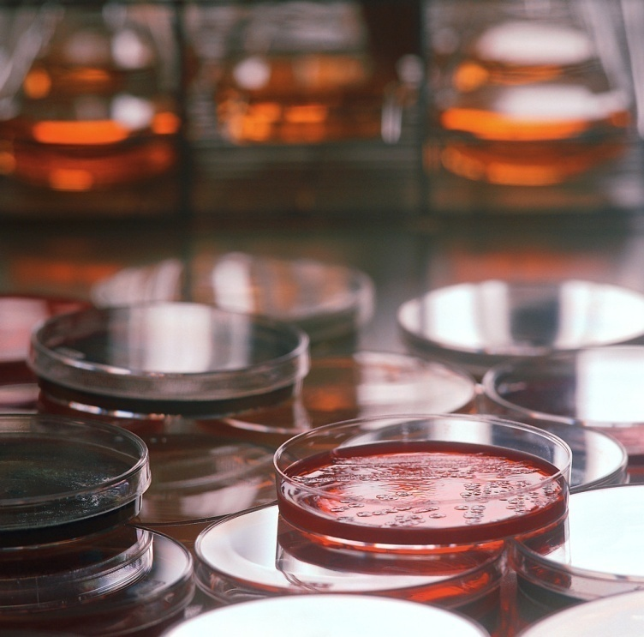
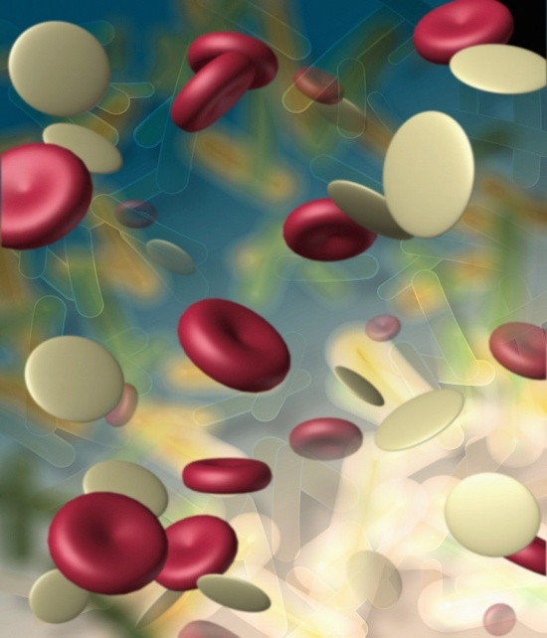
MONERANS
(Bacteria)

Slide 2
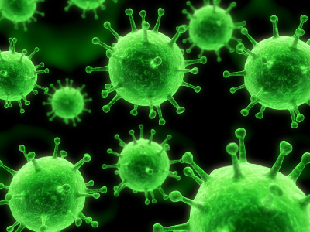
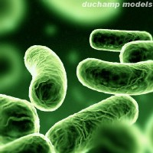
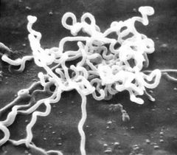
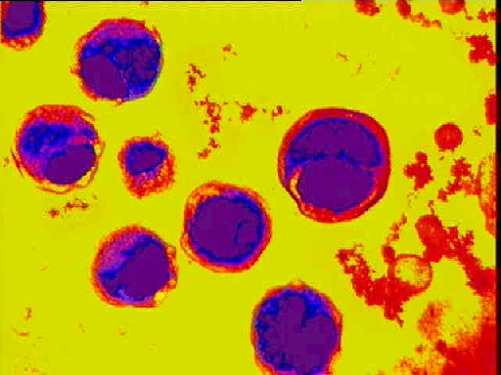
Bacteria’s appearance
A. Colors are reds, yellows, blues, violets
B. rod-shaped, spiral, spherical

Slide 3
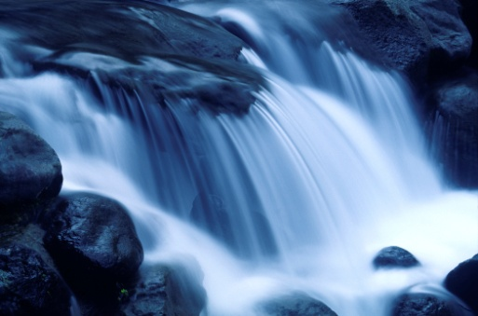
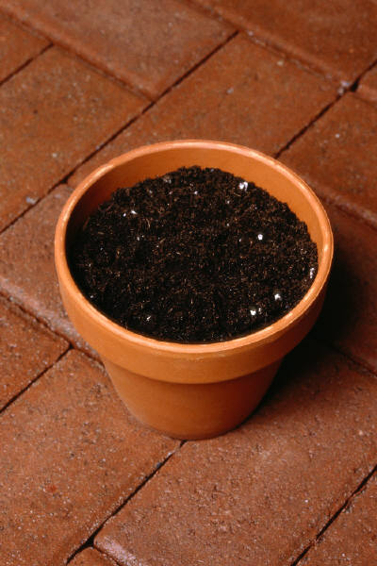
Where they’re found
A. Water
B. Air
C. Soil
D. Bodies of larger organisms
E. Live everywhere, even where living things cant survive

Slide 4

characteristics
A. Some live alone as single cells
B. Others live in groups of cells that are attached to each other
C. Has cell wall
D. Has coating capsule it protects it
E. Has cell membrane
F. Cytoplasm
G. Some have to be moved by water currents, air, and other objects
F. NO NUCLEUS !

Slide 5
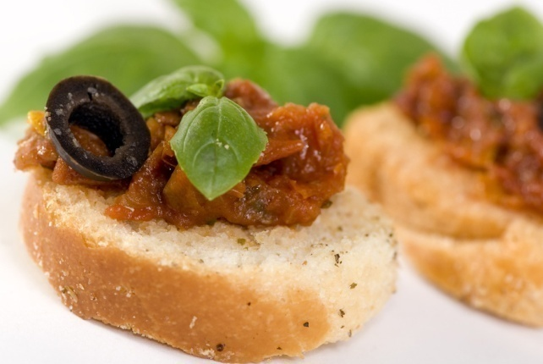
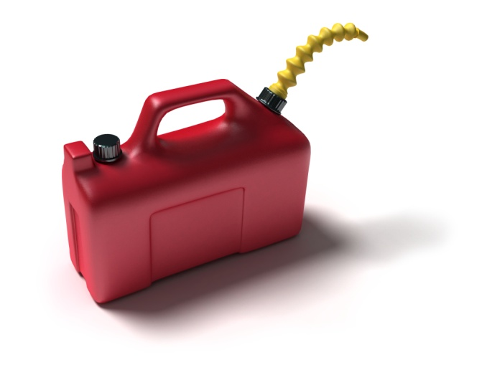
Beneficial applications of bacteria
Food productions
Fuel productions
Medicine productions
Breaks down waste materials
Break down harmful chemicals

Slide 6

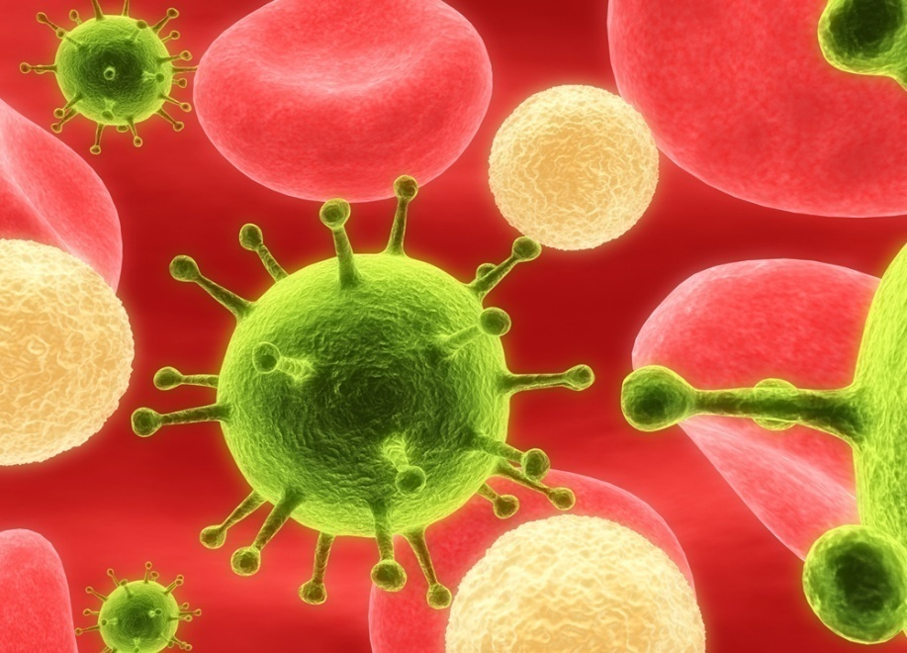
Harmful ways of bacteria
Some bacteria spoil food and poison water supplies
Some causes diseases
Damage property

Slide 7
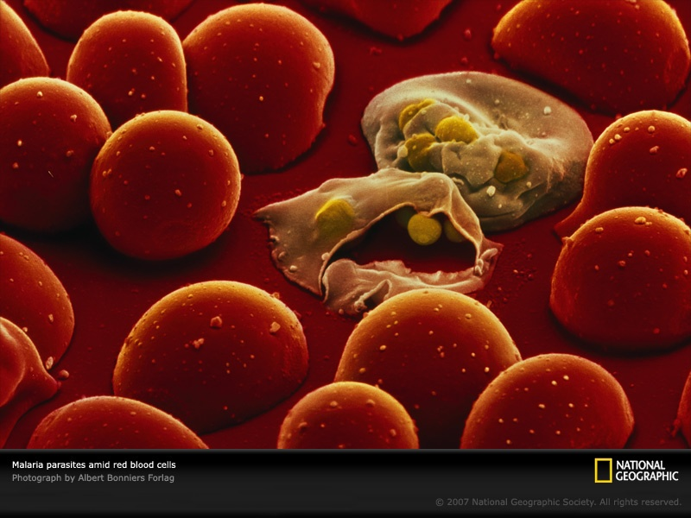
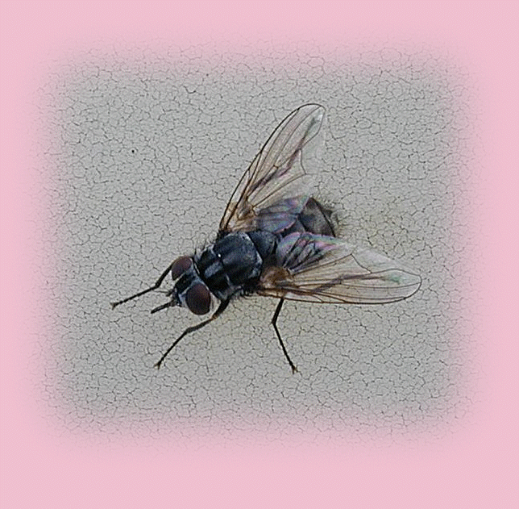
How to get food
Autotrophs Hetrotrophs
parasites
decomposers

Slide 8
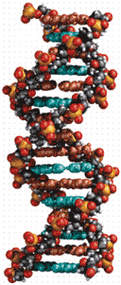
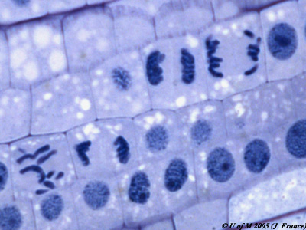
Reproducing
Bacterial cells grow and then reproduce by dividing into 2 cells
Some can double in a number every 20 minuets

Slide 9

The end!
    Hope you enjoyed it!

