Slide 1
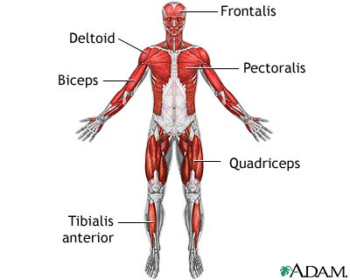


MUSCLUAR SYSTEM
By Hannah, Madi, and Faith

Slide 2
Interesting facts about muscles
If we did not have cardiac muscles in our bodies our heart would not be able to pump blood throughout our bodies!!!!
Did you know muscles in your body are made to contract or shorten?
Did you know that it takes 100 muscles to write your name ?
Muscle tissues are made of fibers that run beside each other.

Slide 3
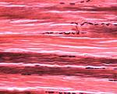

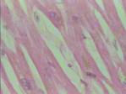
There is three types of muscles
One type is skeletal muscles
Another type is smooth muscles
The last type is cardiac muscles
skeletal
smooth
cardiac

Slide 4

The Skeletal Muscle:
This muscle is also called voluntary and striated muscles
Tire very quick
React quick
If they don’t contract you would not be able to move

Slide 5
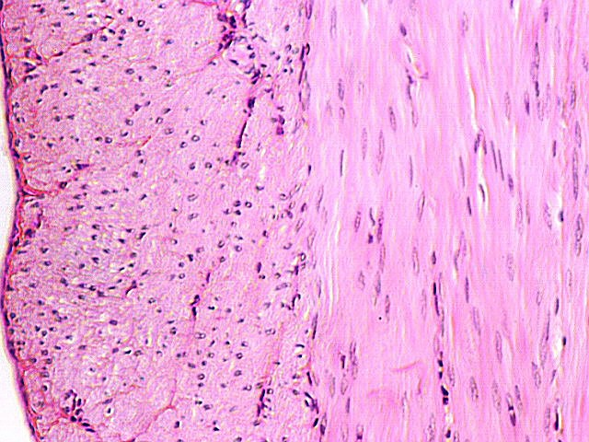
The Smooth Muscles:
Do not have bands
They are involuntary because they contract without you making it
This type of muscle is used for breathing, blood pressure, and movements of the digestive system
React slowly
Tire slowly

Slide 6

The Cardiac Muscles:
Do not tire, if they do tire you would die
The heart is the only place you can find a Cardiac muscle
It branches out into many directions
This muscle makes the heart beat

Slide 7
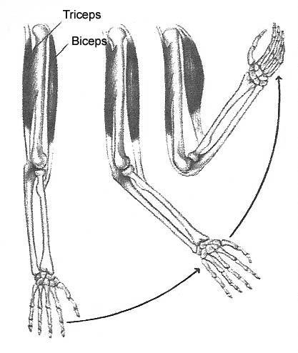
Moving your muscles
If you bend your arm like you are going off your muscles your biceps contact and triceps relax
When you straiten your arm your triceps contract and your biceps relax

Slide 8
Contracting muscles
Nerves carry messages from brain and spinal cords to muscles start contracting
There are no strong or weak contraction of a muscle fiber
The strength of the contraction depends on how many muscles get the message from the brain
Your strong muscles contract when you hit a ball with a bat than to open a text book

Slide 9

                The End

