Slide 1
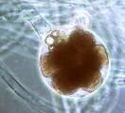
Protists
By Ivy, Bailey, and Hannah

Slide 2
Characteristics
Unicellular ( made up of one cell)
Bigger than monerans but you need a microscope to see them
Has a nucleus
Live in a watery environment
Live alone but may live in colonies
Evolved about 1.5 billion years ago

Slide 3
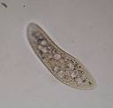

Appearance
Pseudopod- “false foot” (big blob)
Cilia-like tiny oars to help it move and acts like a senors (are tiny hairs)
Flagellates-propels a cell through its environment with a whip-like tail

Slide 4

location
Most are found in a watery environment( salty oceans ,fresh water, and in moist soil)
Others live inside larger organisms (parasites)

Slide 5


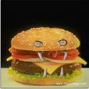
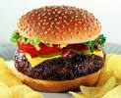
Get food
Autotrophs
Heterotrophs

Slide 6
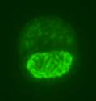
Reproduce
Binary fission- split in two

Slide 7
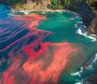
Harmful
Some can cause diseases in humans and animals
For example it causes African sleeping sickness and diseases in the intestines
Malaria is a disease
Another disease is red tide that may kill you

Slide 8

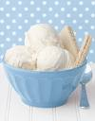
Beneficial
Protists shells can be used for building, writing, drawing, and chalk
Can be used in creamy food items (ex. Easy cheese, frosting, and some ice creams)

Slide 9

THE END

