Slide 1
Science Fair!
Everything you need to know. . .

Slide 2
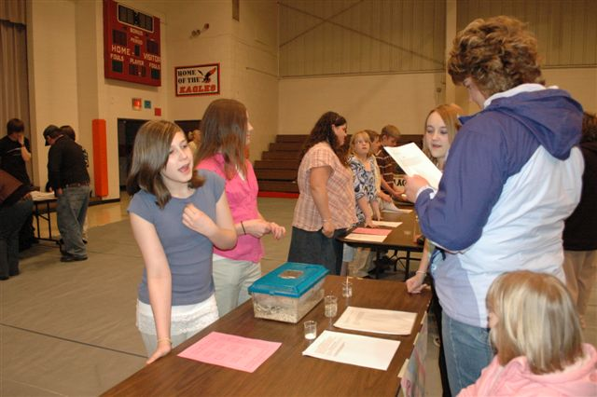
What is a science fair project?
Student groups design & perform an experiment following the scientific method.
Each group member will prepare a written scientific method.
The group will create an informative display about the experiment.
These projects allow students to experiment, make decisions, form and reform hypothesis, test and examine ideas, seek solutions, and most important learn more about themselves and their world.

Slide 3

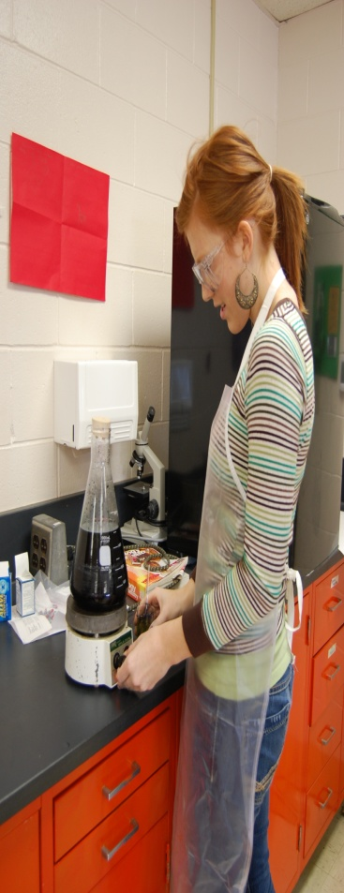
Guidelines
All projects must follow the experimental format.
All projects must be approved by the classroom teacher.
No experiments or demonstrations may be conducted that will endanger humans or animals.
All supplies must be supplied by the students and their parents if they are not available from the science room.
Groups must contain 2-3 students. All partners must contribute—individual grades will be assigned for individual contributions. Each group member will be responsible for his/her own information (scientific method). All members’ reports will be displayed at the fair.
Each entry must have a display which may not take up more than ½ table.
All safety precautions must be followed.

Slide 4
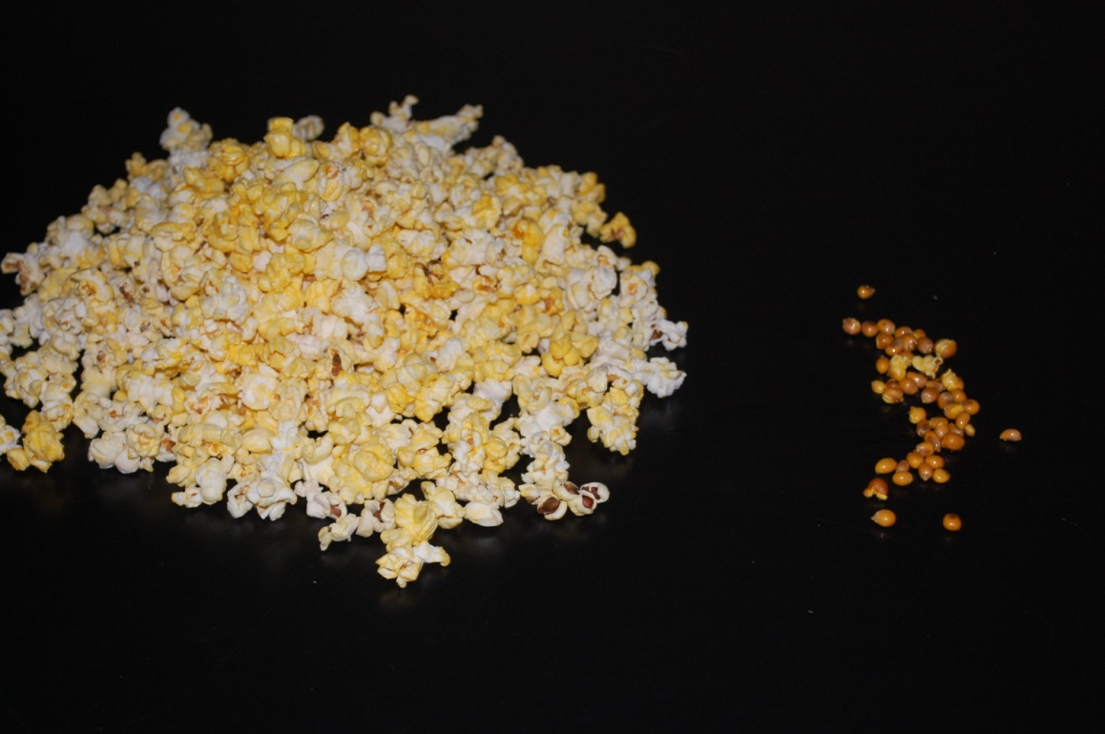
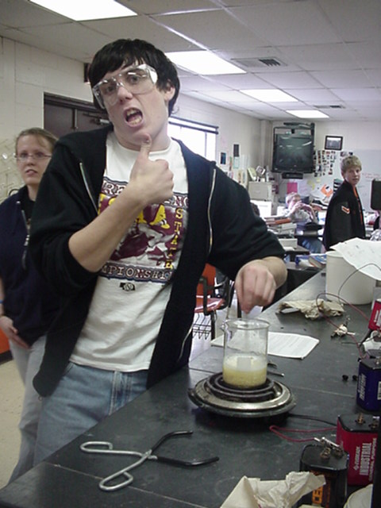
Choosing a topic
Pick a topic that you have a question about
It will be directly related to your class (i.e. Biology students choose a biology topic)
Most importantly: Pick something you ENJOY!

Slide 5

Steps of the scientific method
Stating the problem
Gather information on the problem
Forming a Hypothesis
Perform experiment to test the hypothesis (procedure)
Record and analyze data (results)
State a conclusion
Repeating the work

Slide 6
State the Problem
What do you want to find out?
State the general area of study—no specifics yet
Usually no more than one sentence

Slide 7
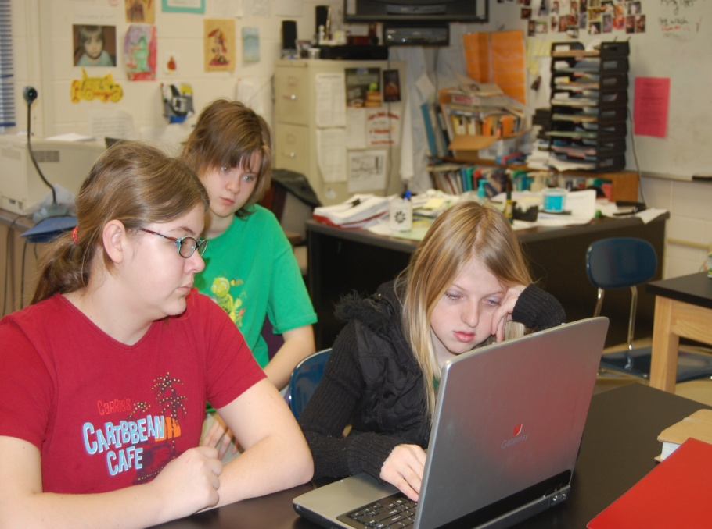
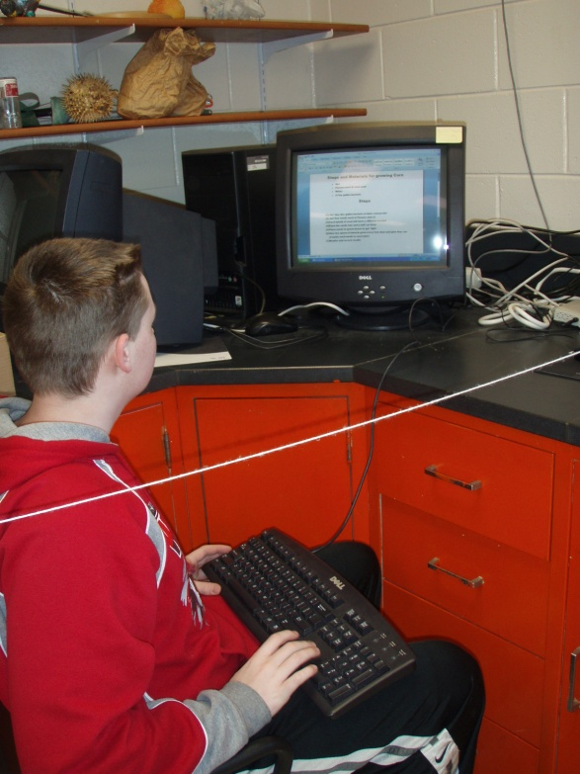
Research
Search for all important information related to the problem and write as a research paper.
You may use a combin-ation of the following: Internet, CD Roms, books, magazines, museums, & experts.
Keep accurate notes of all sources of information. These will be included at the end of your research paper.

Slide 8
Research Rubric

Slide 9
Make a Hypothesis
Make an intelligent guess
What do you think will happen?
You will build your research around this statement
???

Slide 10
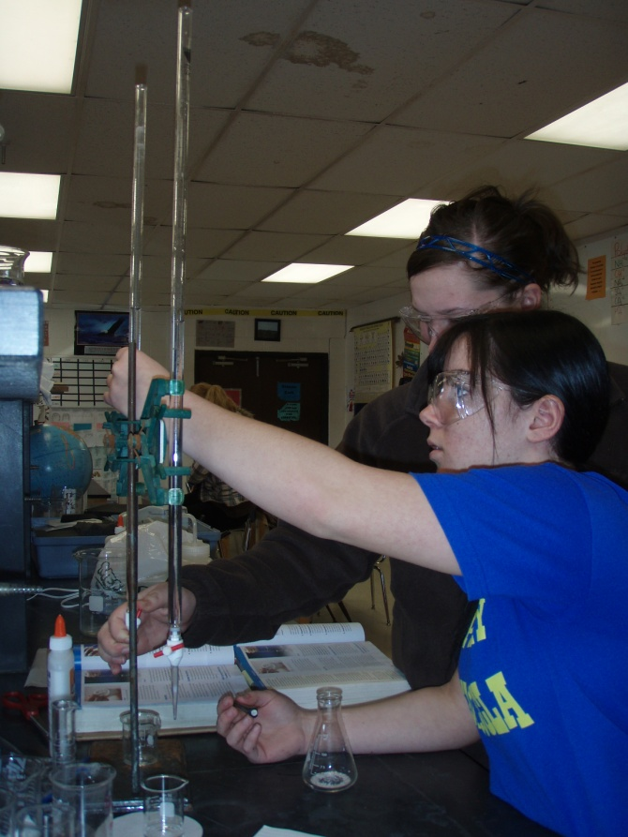
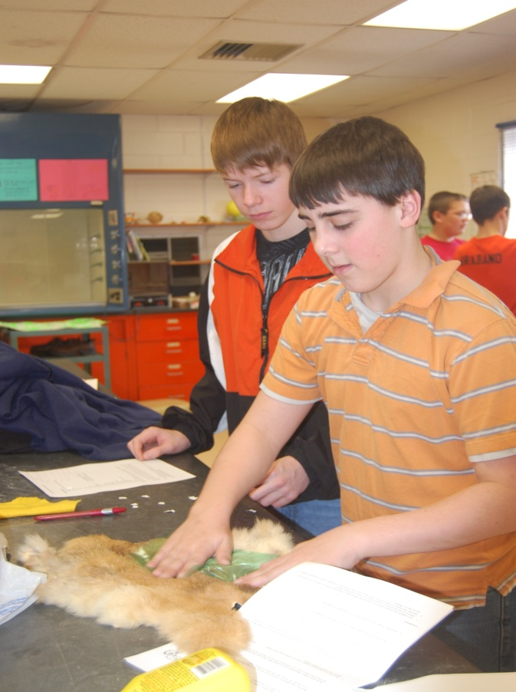
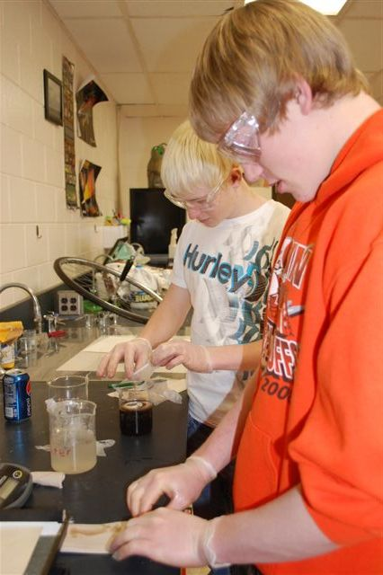
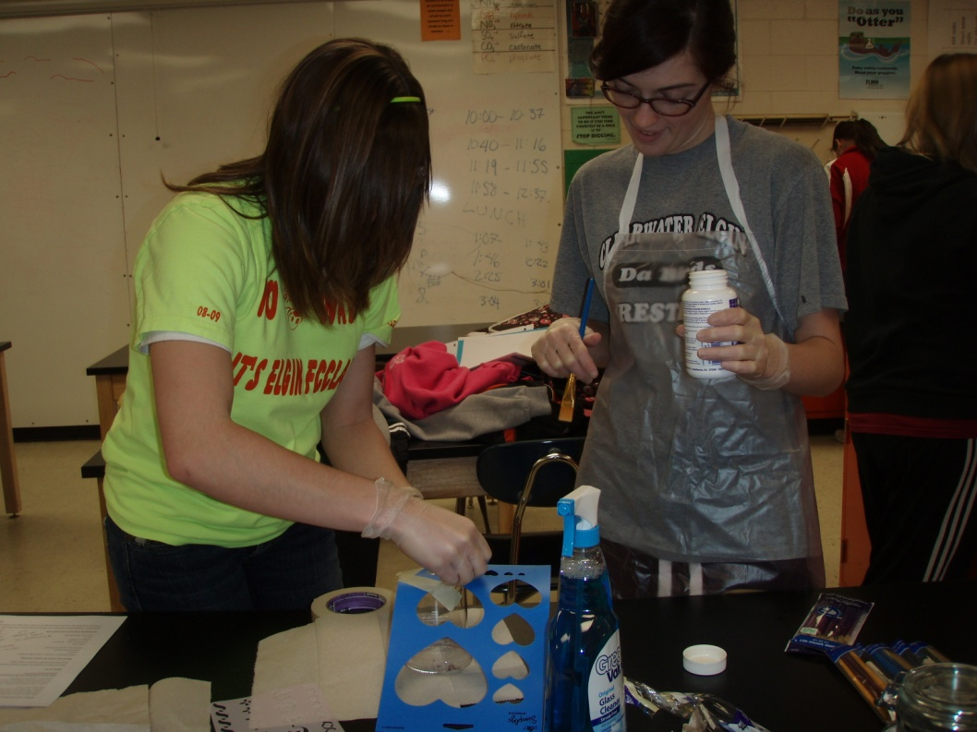
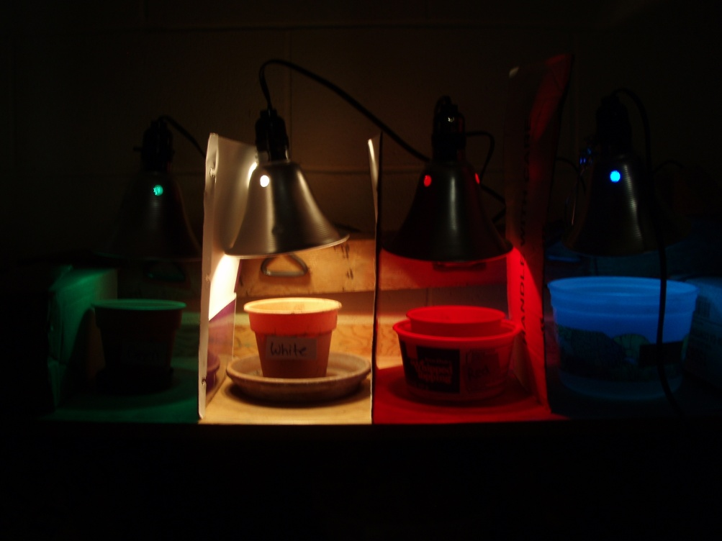
Procedure
Select the best method in designing your experiment. Possibilities include: survey, observation, comparison, and controlled.
Test only one variable
Keep a detailed log of all steps—someone should be able to copy your steps and perform the exact same experiment

Slide 11
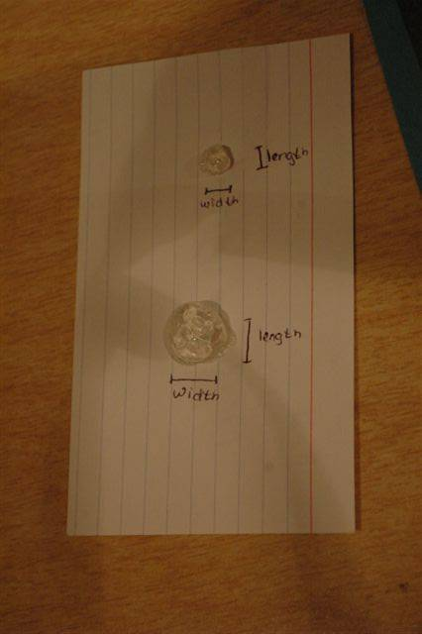
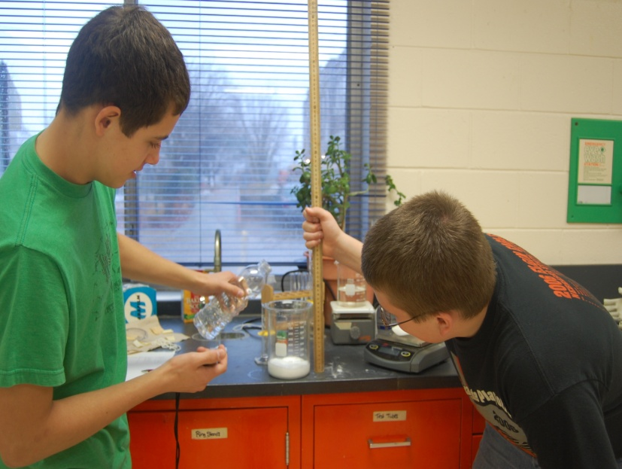
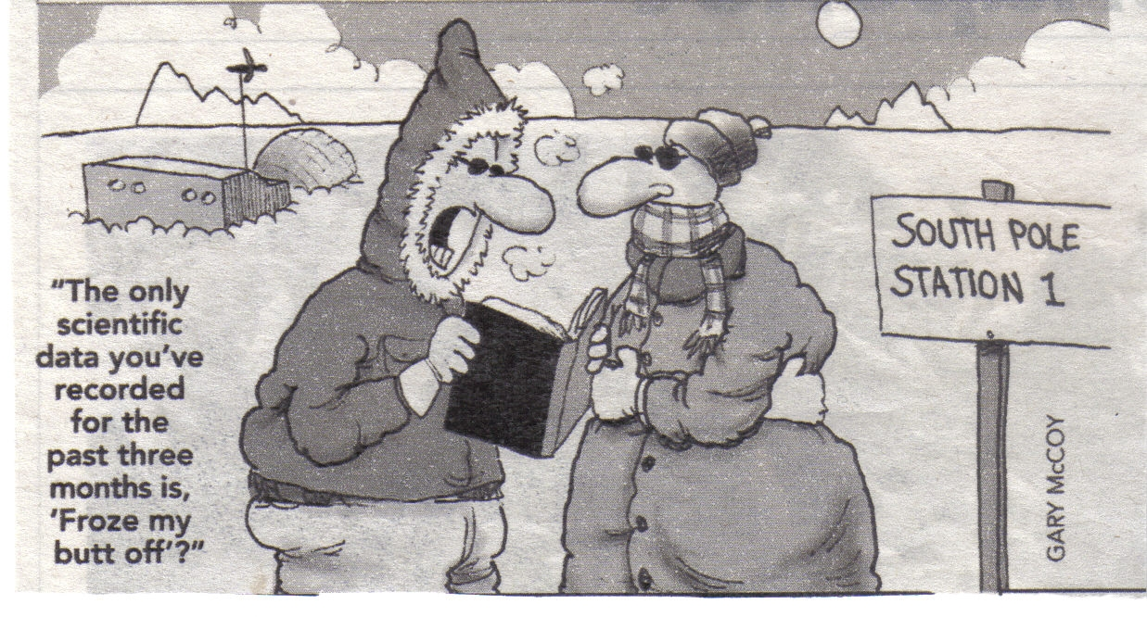
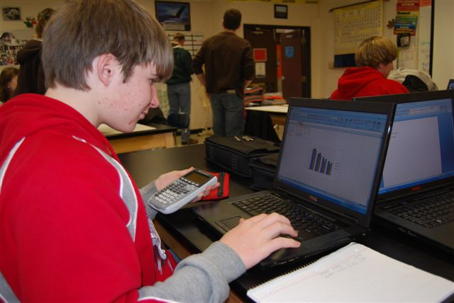
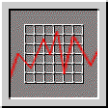
Record and Analyze Data (Results)
Data will be recorded and displayed in a logical manner
Recording results:
  Use the metric system for all measurements
  Locate & properly use the right lab equipment
Displaying results:
  Use chart or graph when possible
  Create on the computer

Slide 12
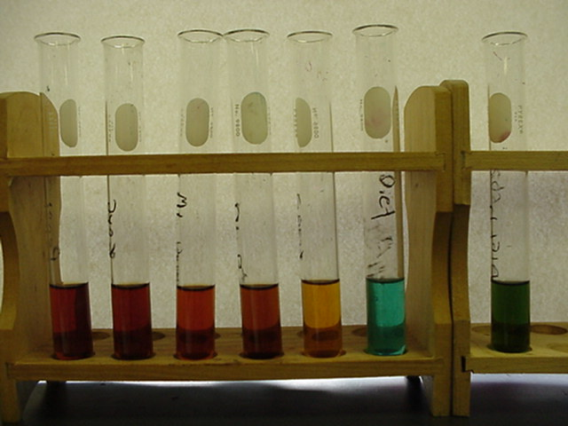
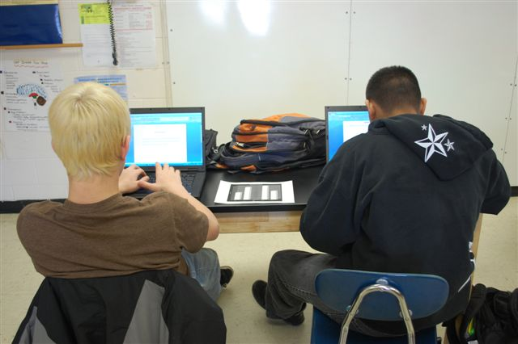
State a Conclusion
At the end of your testing, review the results. What happened?
Include the following:
  Was your hypothesis correct?
  Why did these results happen?
  Are your results accurate? Why?
  What would you do differently next time? Why?
  What did you learn by conducting this experiment?
  What are the real-life applications of this experiment?

Slide 13
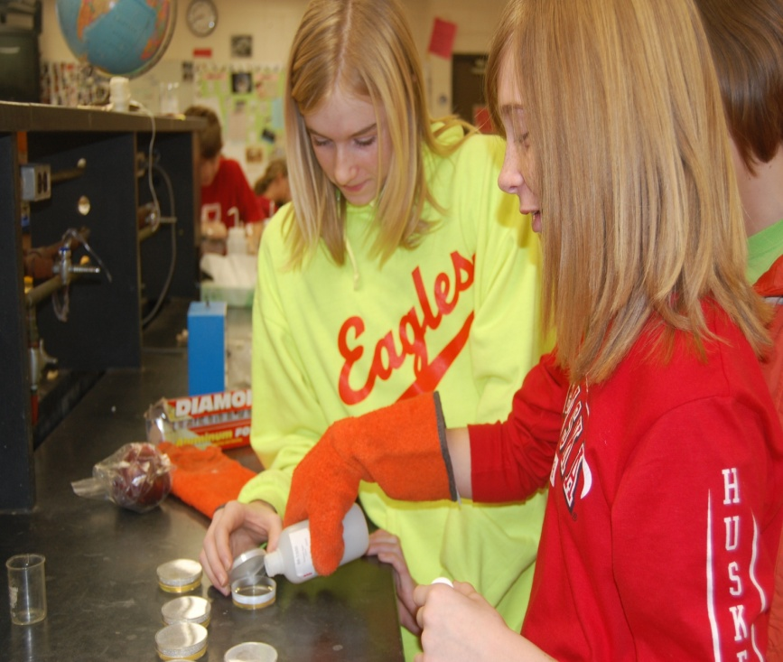
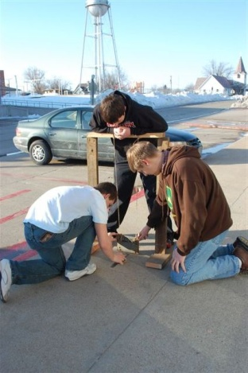
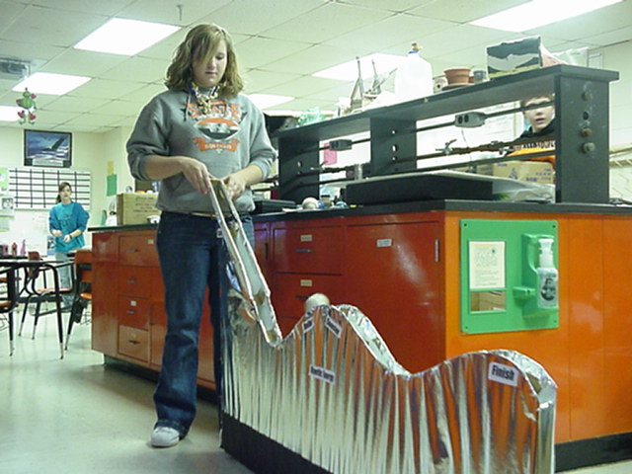
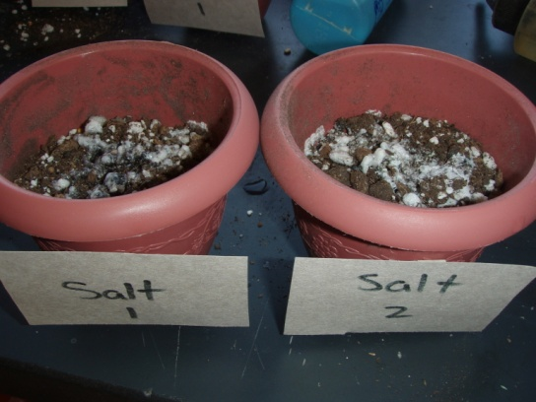
Repeat the Work
Repeat work to prove the evidence is accurate
May perform multiple tests at once or repeat the work at the completion of the initial testing
Repeat if time allows

Slide 14
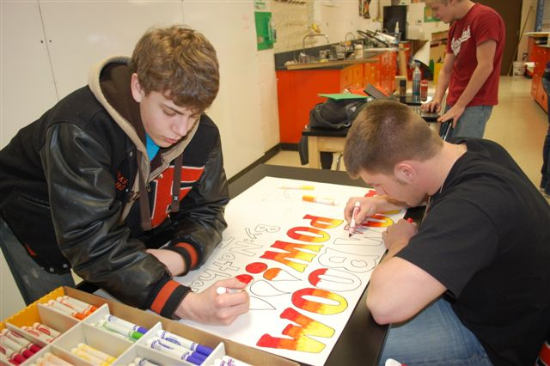
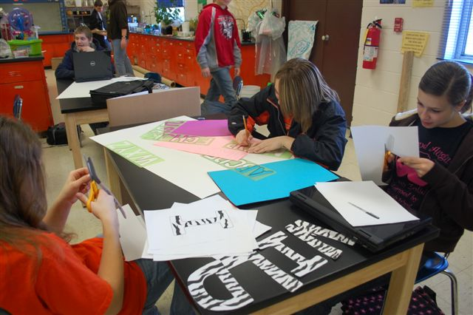
Presenting your Project
All steps of the scientific method and display materials will be typed
Your area for display will be ½ table (4’ in length, 16” in depth—exceptions may be made)
Your display must begin with an appropriate “attention getter” such as a catchy title, a question, comment, or quotation
Your display must incorporate 2+ illustrations or models.
  Illustrations may include graphs, tables, charts, maps, pictures, etc.
  Models may include something you have created using your new knowledge, or your testing materials themselves.

Slide 15
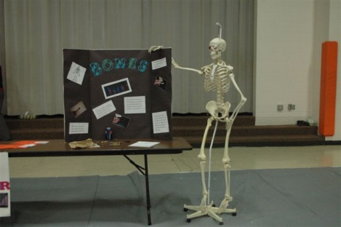
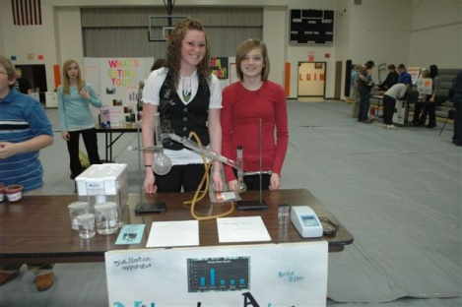
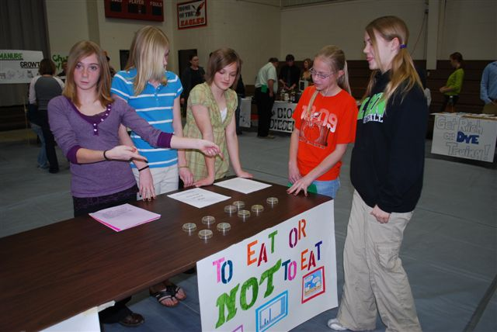
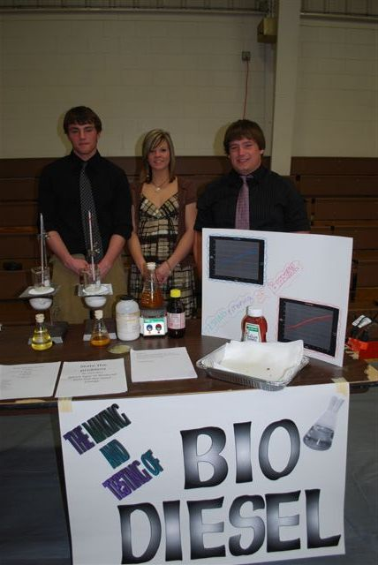
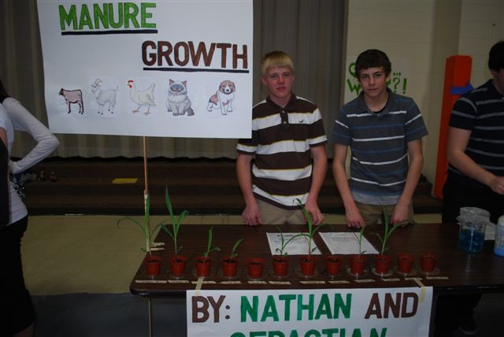
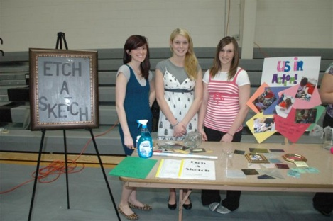
Examples of Displays

Slide 16
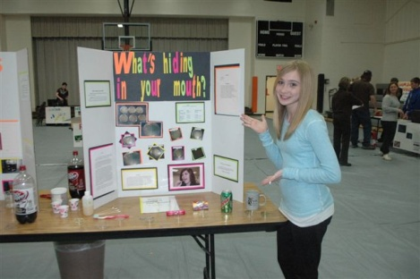
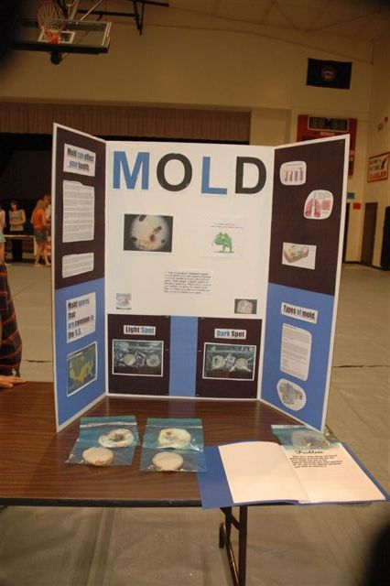
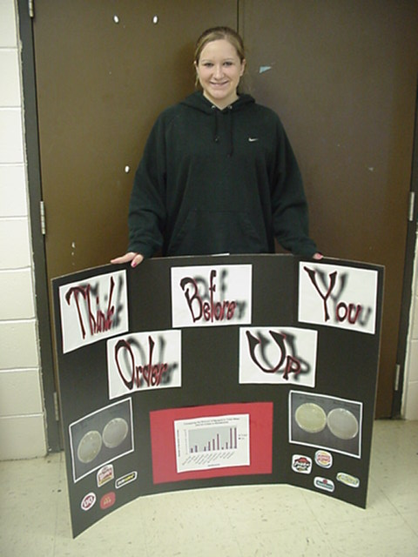
Examples of displays
(Health Science Meet)

Slide 17
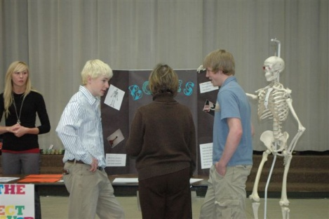
Evaluation
You will be evaluated using 2 scoring rubrics.
  Individual
  Group
These grades will be averaged together
Individual rubric—will be different for each group member; relies on individual scientific methods
Group rubric—will be the same for all group members; is used by judges the night of the science fair and grades presentation

Slide 18
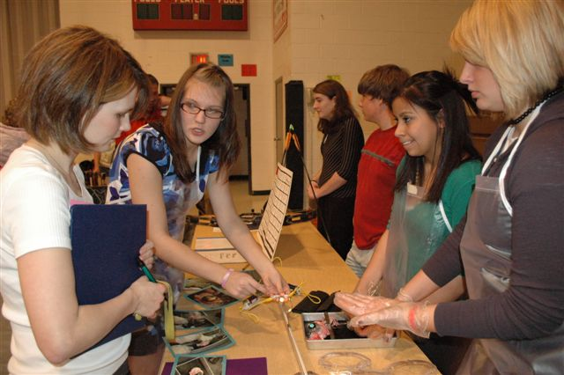
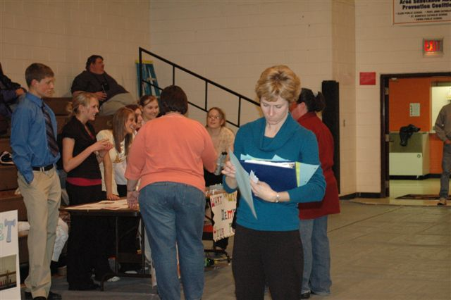
Individual Rubric

Slide 19
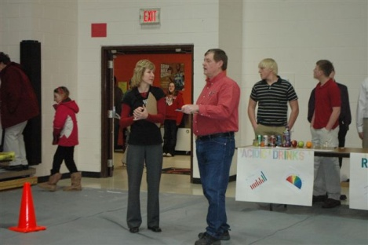
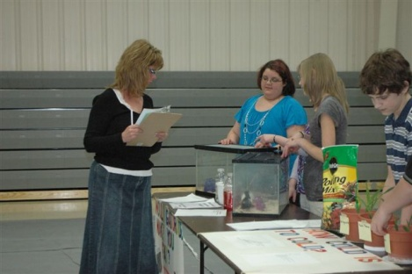
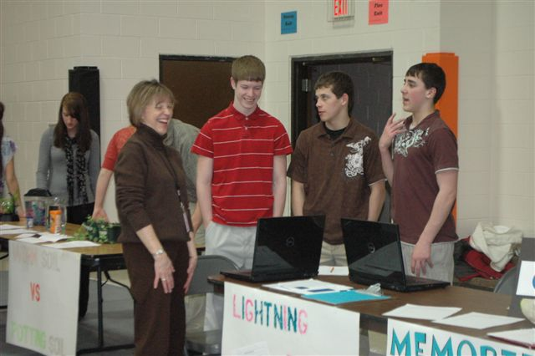
Group
Rubric

Slide 20
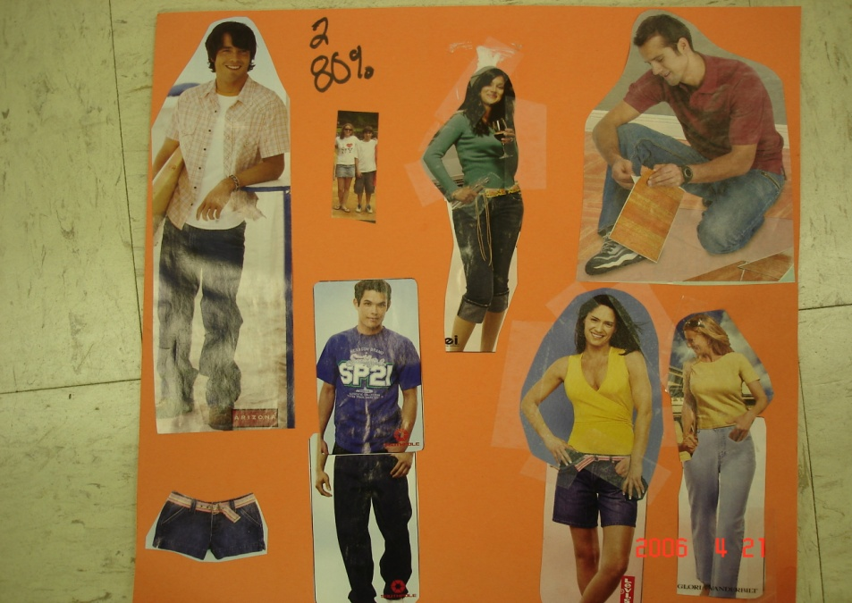
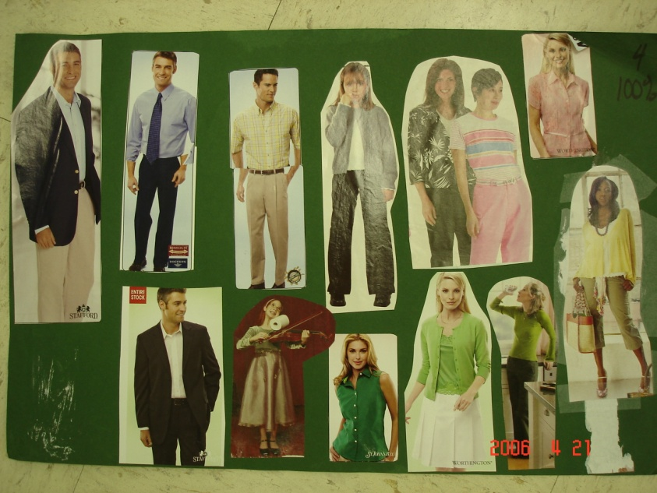
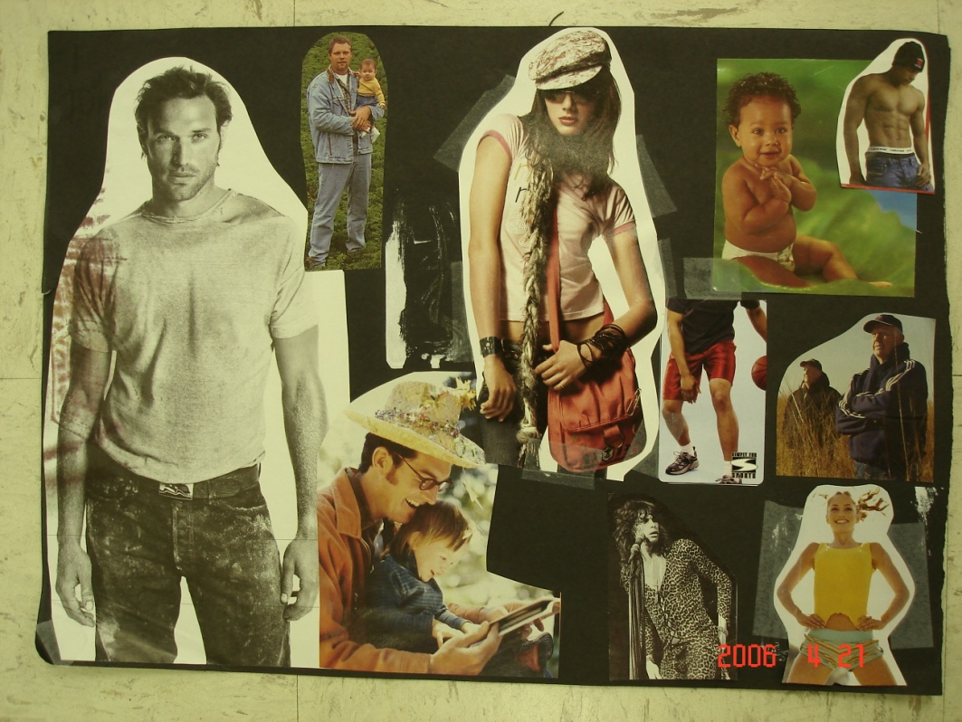
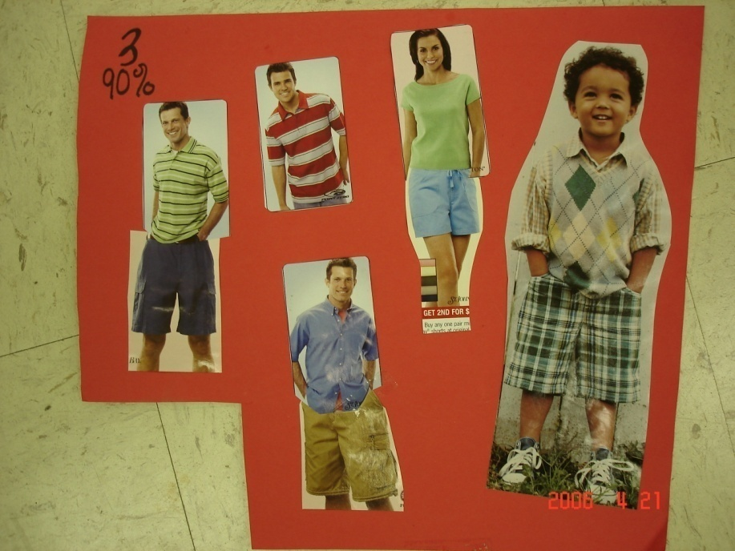
Dress Rubric
Low
Highest
Lowest
High

Slide 21
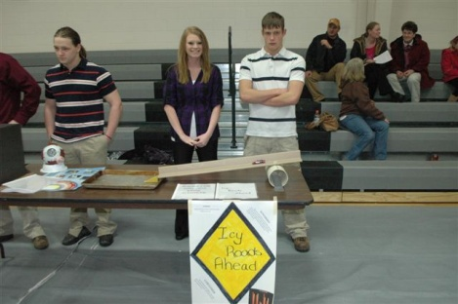
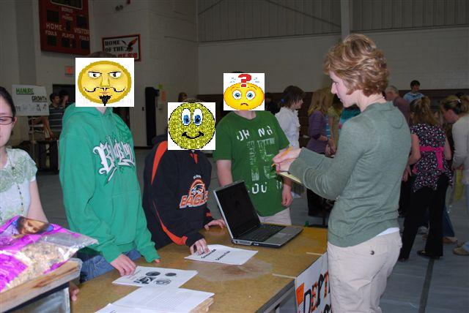
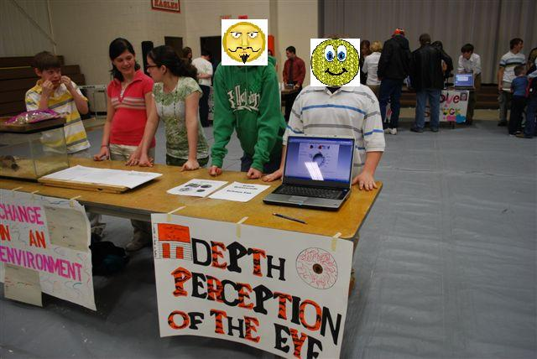
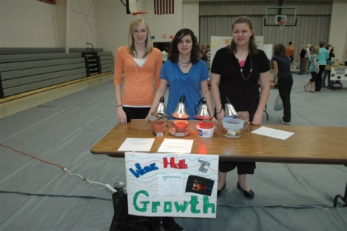
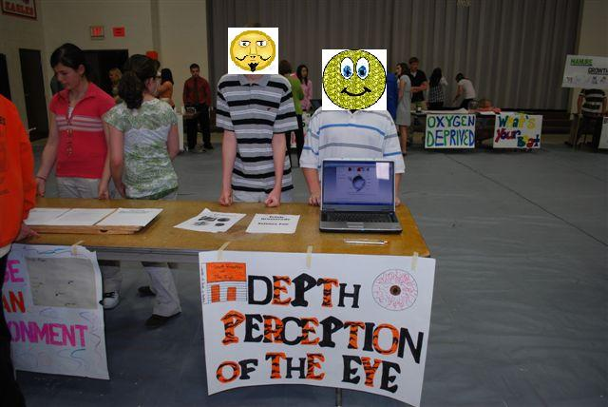
What to wear
And what NOT to wear
Identities have been hidden to
protect those involved.
7 pm
8 pm
9 pm

Slide 22
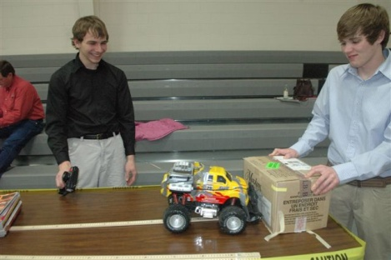
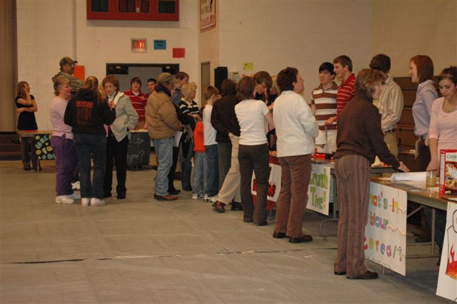



Science Fair Night

Slide 23









Science Fair Night

Slide 24
Calendar
January 2011
Sunday | Monday | Tuesday | Wednesday | Thursday | Friday | Saturday
 |  |  |  |  |  | 1
2 | 3 | 4 | 5 | 6 | 7 | 8
9 | 10 | 11 Groups & topics approved | 12 | 13 Problem Due Student Form Due | 14 WORK DAY Research | 15
16 | 17 | 18 WORK DAY Research | 19 | 20 | 21 Research Due Form Hypothesis | 22
23 | 24 | 25 | 26 | 27 | 28 Hypothesis Due | 29
30 | 31

Slide 25
Calendar
February 2011
Sunday | Monday | Tuesday | Wednesday | Thursday | Friday | Saturday
 |  | 1 | 2 | 3 WORK DAY Testing | 4 No School | 5
6 | 7 1:00 Out SLC | 8 | 9 | 10 WORK DAY Testing | 11 | 12
13 | 14 | 15 | 16 WORK DAY Testing | 17 | 18 No School | 19
20 | 21 | 22 | 23 WORK DAY Procedure | 24 Procedure Due | 25 | 26
27 | 28 No School

Slide 26
Calendar
March 2011
Sunday | Monday | Tuesday | Wednesday | Thursday | Friday | Saturday
 |  | 1 | 2 | 3 Data Analysis Due | 4 No School | 5
6 | 7 Health Science Meet | 8 | 9 | 10 | 11 No School | 12
13 | 14 | 15 | 16 Conclusion Due | 17 | 18 WORK DAY Visuals | 19
20 | 21 | 22 | 23 Visual Display Due | 24 | 25 Completed Projects Due | 26
27 | 28 | 29 | 30 | 31 7-9 pm SCIENCE FAIR

