Slide 1
Skeletal System
By Bailey and Allison

Slide 2
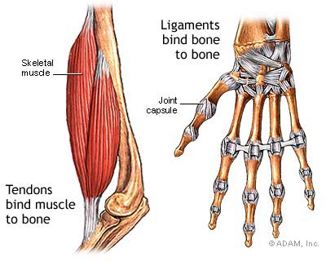
Tissues
There are two kinds of tissues tat hold your bones together
  Ligaments
  Tendons

Slide 3
Functions
There are five main fuctions
  Provides shape and form
  Allows movement
  Protects tissues and organs
  Stores materials
  Makes blood cells
  Movement of muscles allow you to move
  Your back bone protects your spinal cord
  Long bones in your body help make blood cells.(like the ones in your arms and legs)

Slide 4
Parts
There are 206 bones in your body
  Skull femur
  Clavicle patella
  Scalpula fibula
  Sternum tibia
  Ribs tarsals
  Vertebral metatarsals
  Column
  Ulna
  Radius
  Sacrum
  Carpals
  Metacrapals
  Phalanges

Slide 5
development
Made of cartilage
Most cartilage is replaced by bone
Cartilage cushions bone
Provides a slippery surface

Slide 6
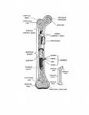
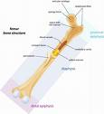
Structure
Bone is the toughest but lightes material in your body
Long bones contain marrow
Marrow is soft material inside a bone

Slide 7


Joints
Joints keep the bones far enough away from each other so they don’t rub
Hold bones in place
Three kinds of joints
  Pivot joint
  Hinge joint
  Ball-and- socket joint

Slide 8
                the end

