Slide 1
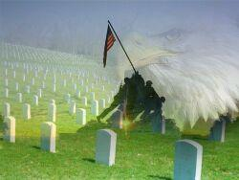

Elgin
Veterans

Slide 2
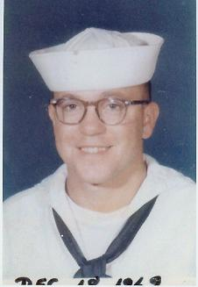
Alfred
Bauer
Navy
1969 - 1973

Slide 3
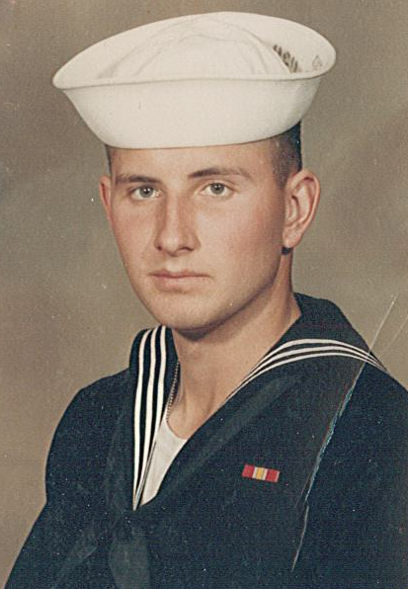
Allen Beckman
Navy
1967 - 1969

Slide 4
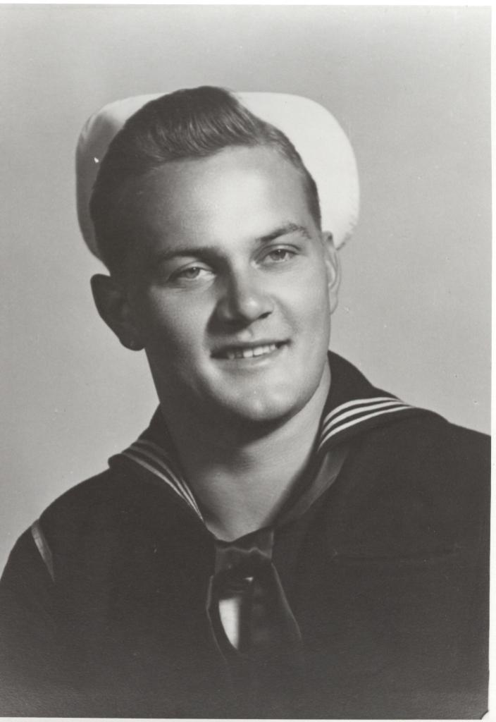
Alvin Schrage
Navy
1944 - 1946

Slide 5
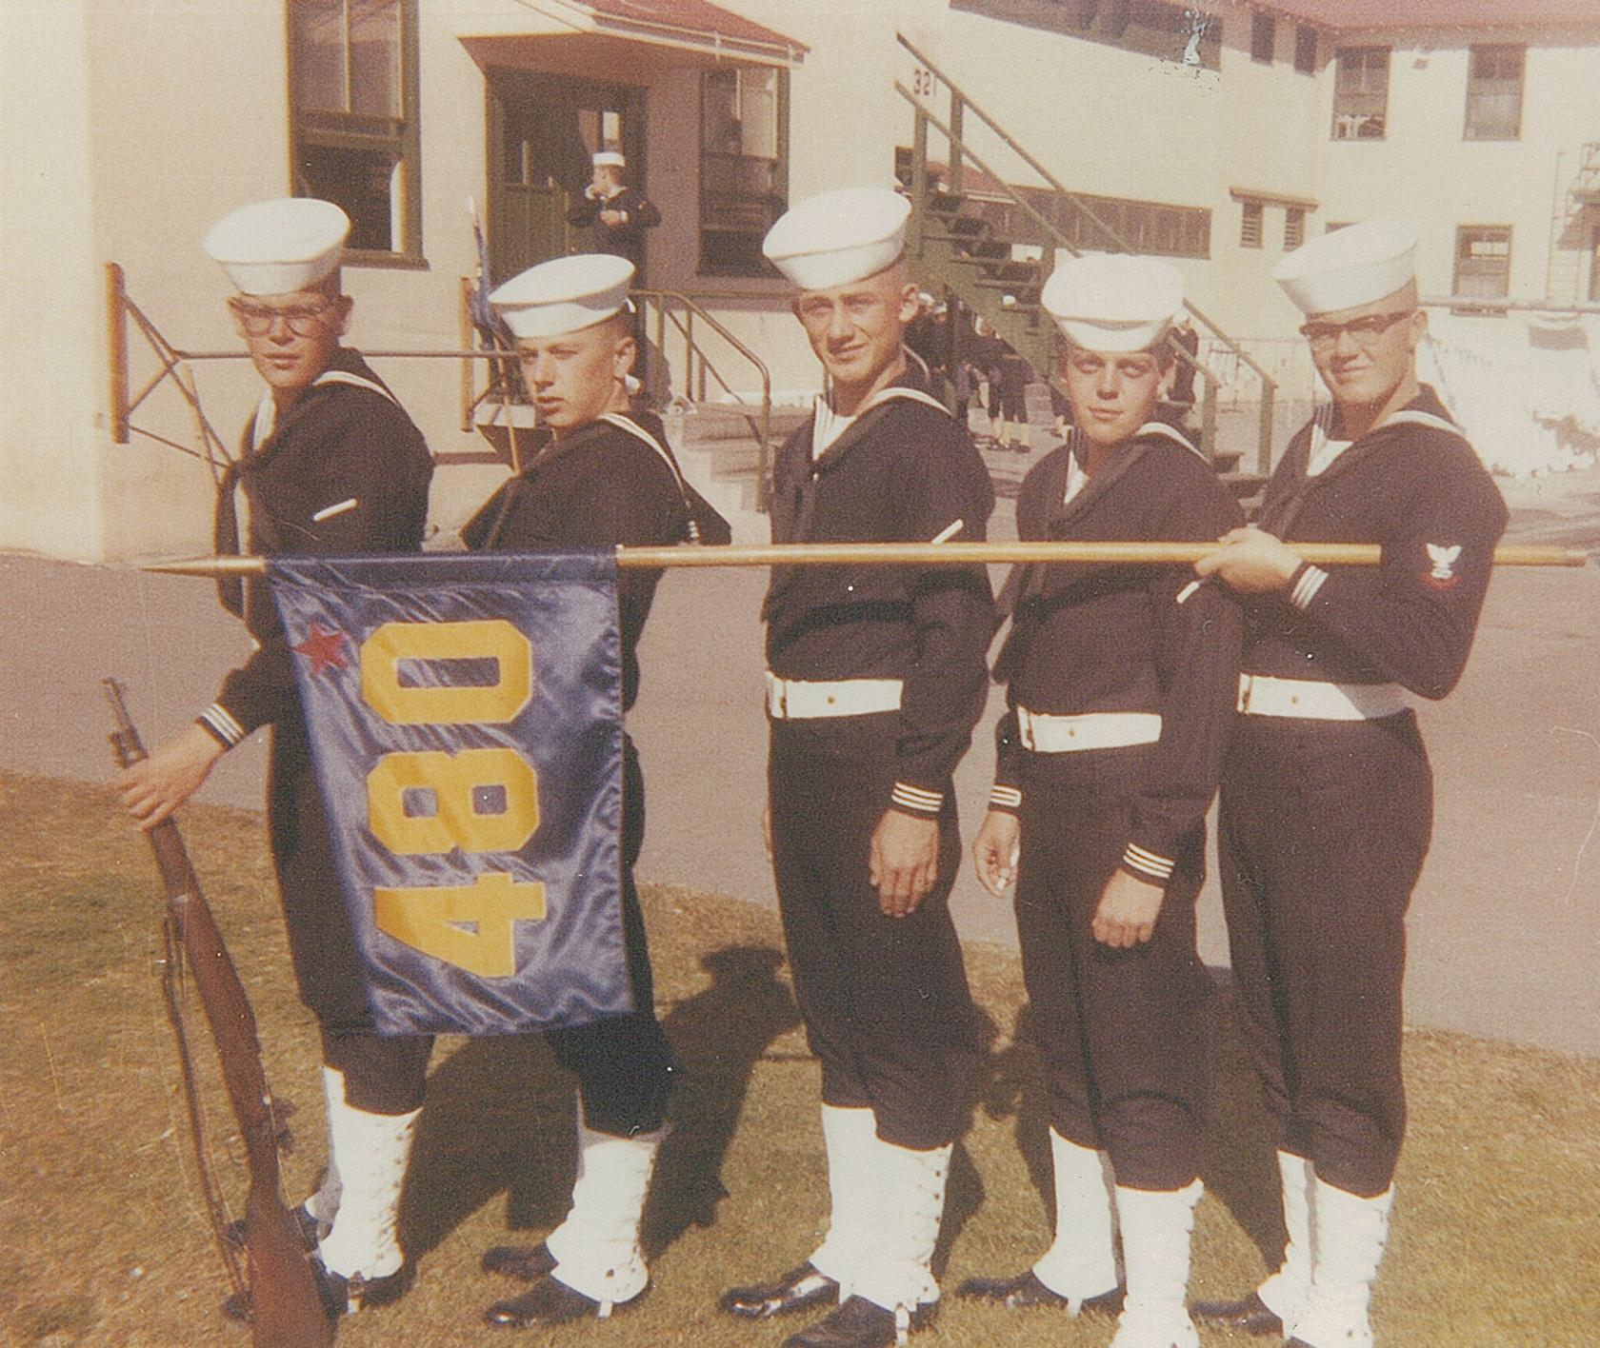
Bill Vanourney Joe Beck
Leonard Beelart
Jim Stradcutter Craig Stradcutter

Slide 6
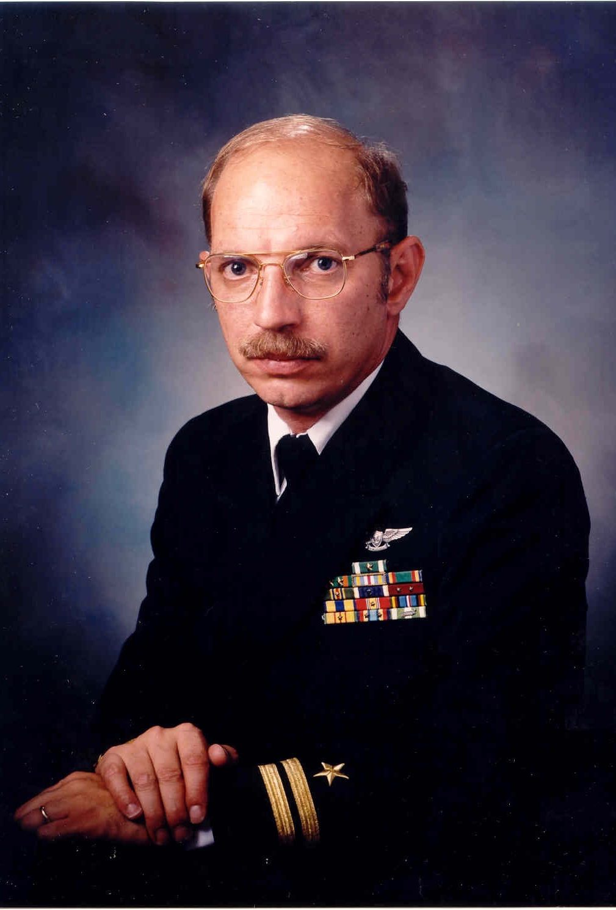
Bill Getzfred
Navy
1972 - present

Slide 7
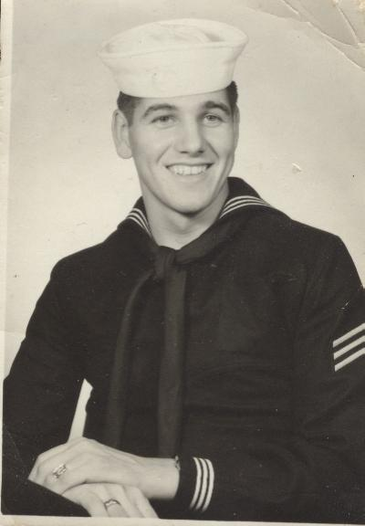
Billy Alderson
Navy
1955 - 1958

Slide 8
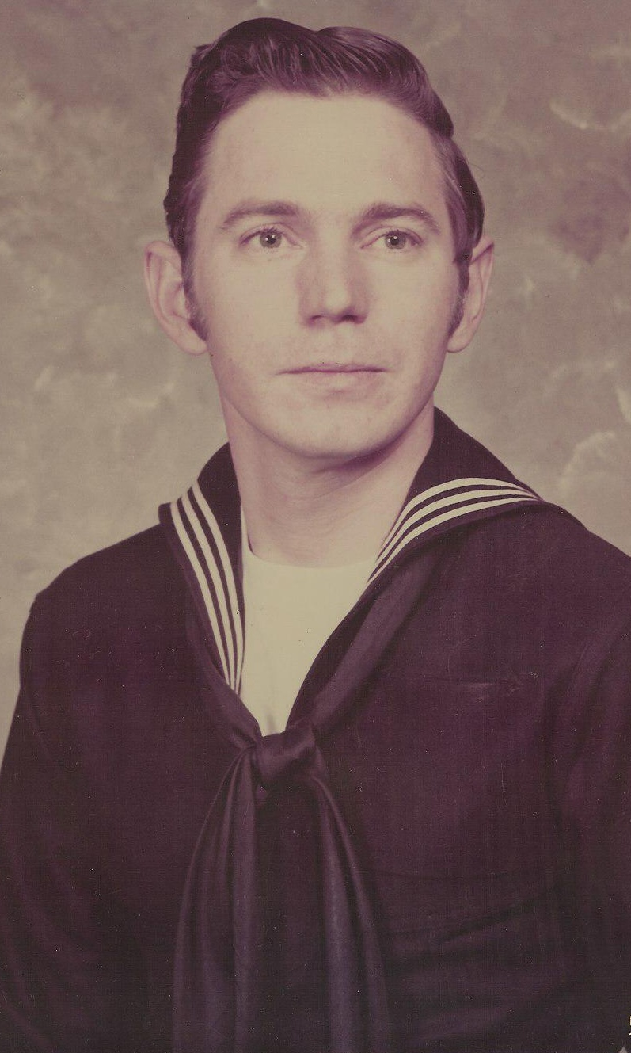
Bob Getzfred
Navy
1962 - 1966

Slide 9
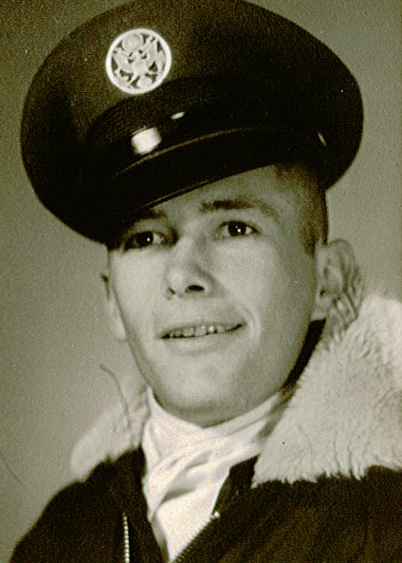
Brian
Mack
Air Force
1956 - 1960

Slide 10
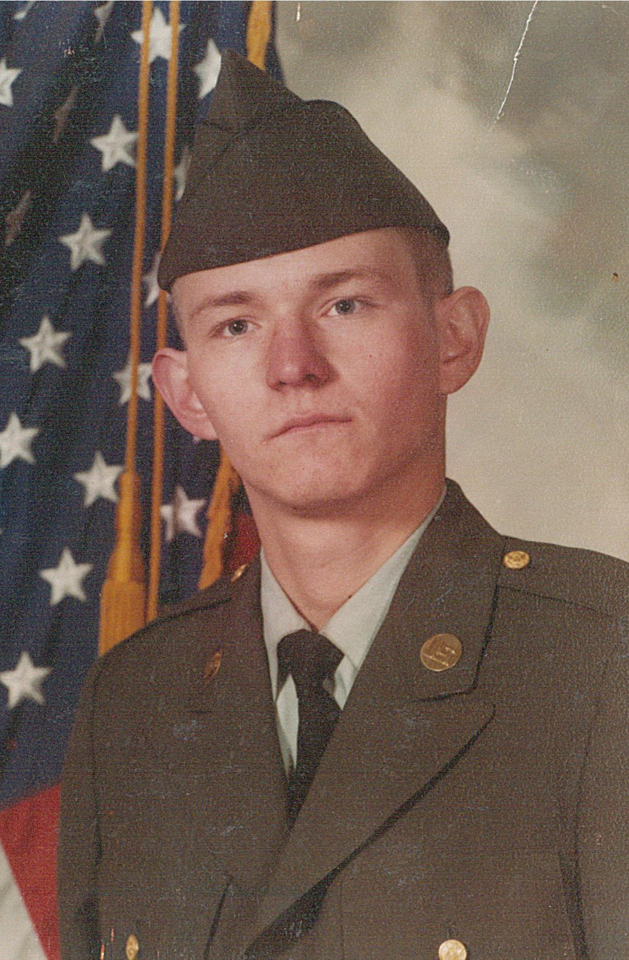
Byron
Bergman
Army
1984 - 1992

Slide 11
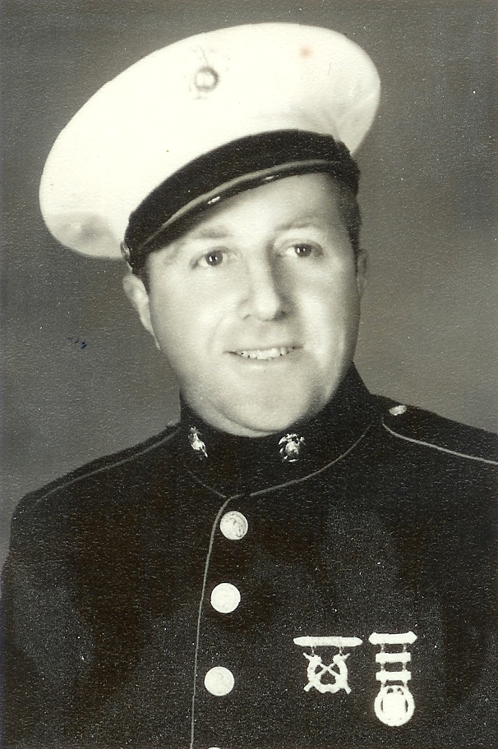
Charles
“Chick”
Rethmeier
Marines
1943 - 1945

Slide 12
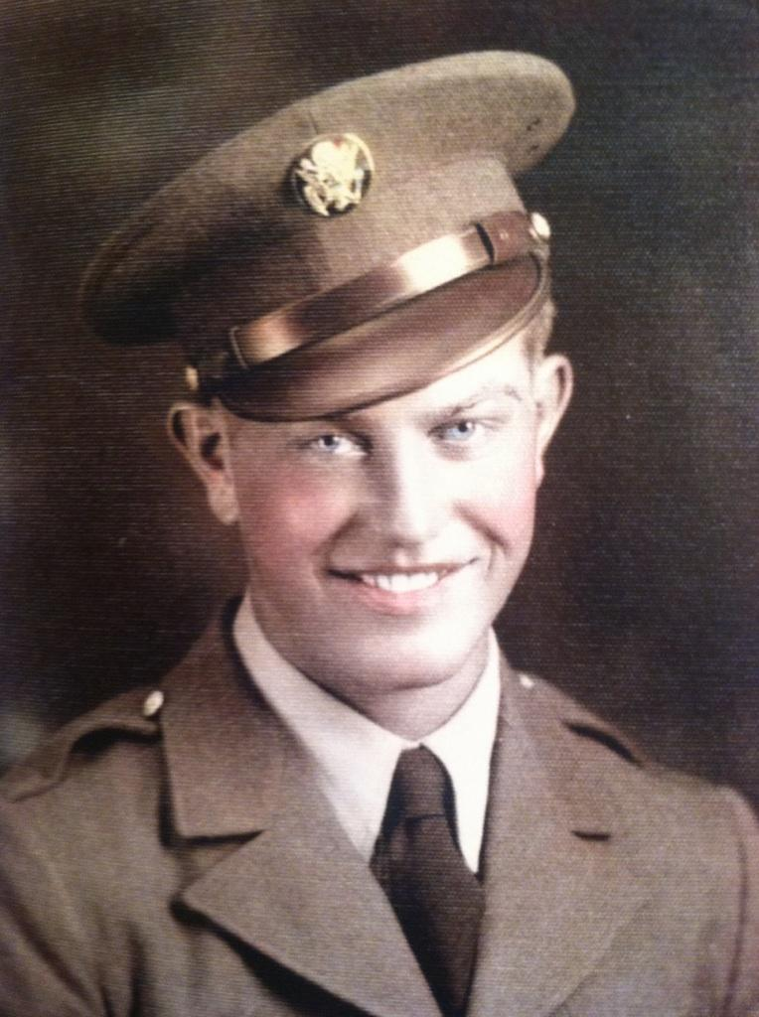
Clarence
Schmitt
Army
1942 - 1946

Slide 13
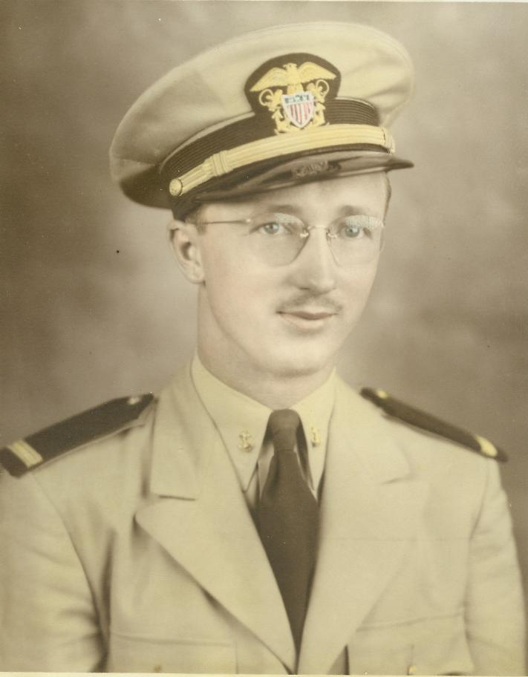
Dallmont J. Erickson
Merchant Marines & Army
1943 - 1946

Slide 14
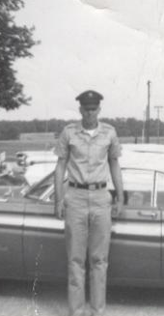
Dennis Suhr
Army
1964 - 1967

Slide 15
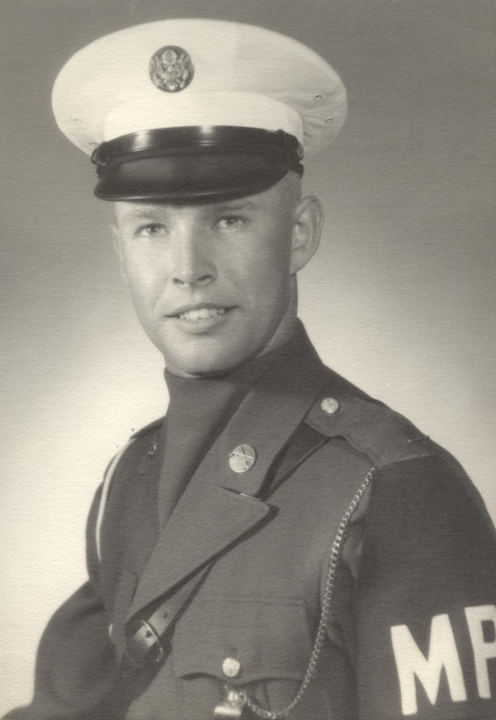
Dennis Wiehn
Army
1964 - 1966

Slide 16
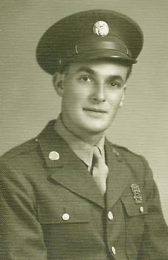
Denzel J. Anderson
Army
1944 - 1946

Slide 17
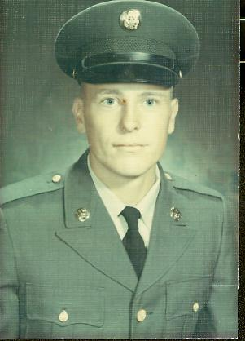
Don Bauer
Army
1967 - 1969

Slide 18
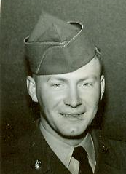
Donald J. Henkenius, Sr.
Army
1953 - 1955

Slide 19
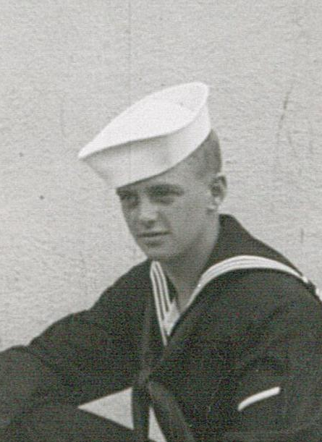
Donald Mackel
Navy
1956 - 1958

Slide 20
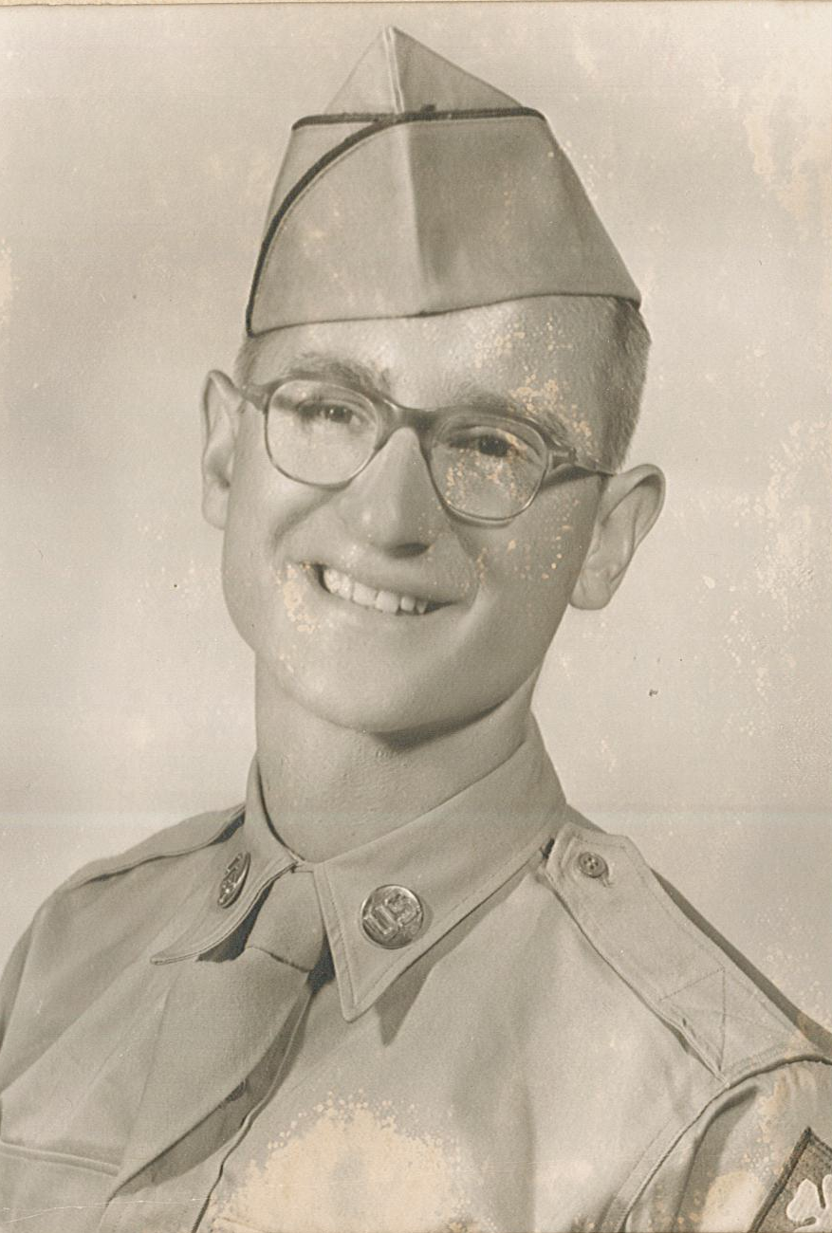
Duane Dinslage
Army
1952 - 1954

Slide 21
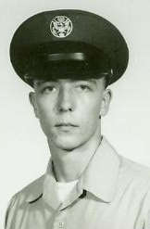
Dwayne Bauer
Air Force
1970 - 1978

Slide 22
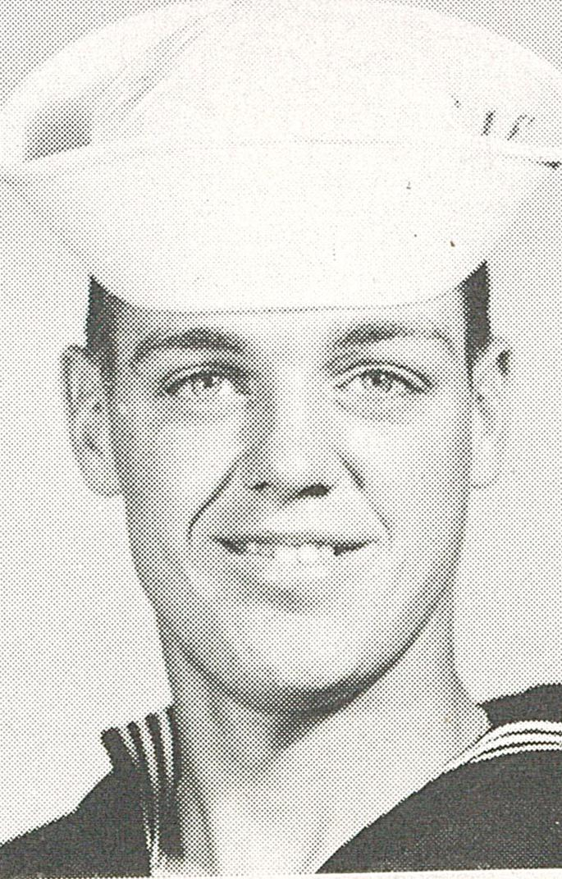
Eugene Mackel
Navy
1955 - 1959

Slide 23
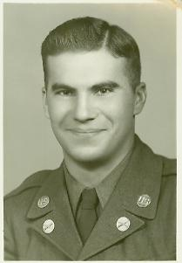
Floyd Henn
Army
1951 - 1953

Slide 24
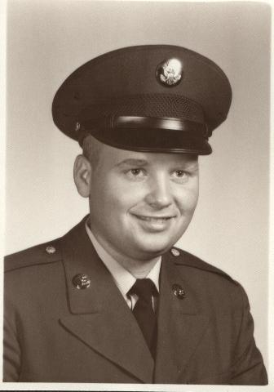
Gale G. Mahnke
Army
1966 - 1968

Slide 25
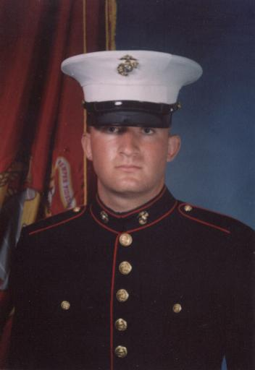
Garrett Dwyer
Marines
2004 - 2008

Slide 26
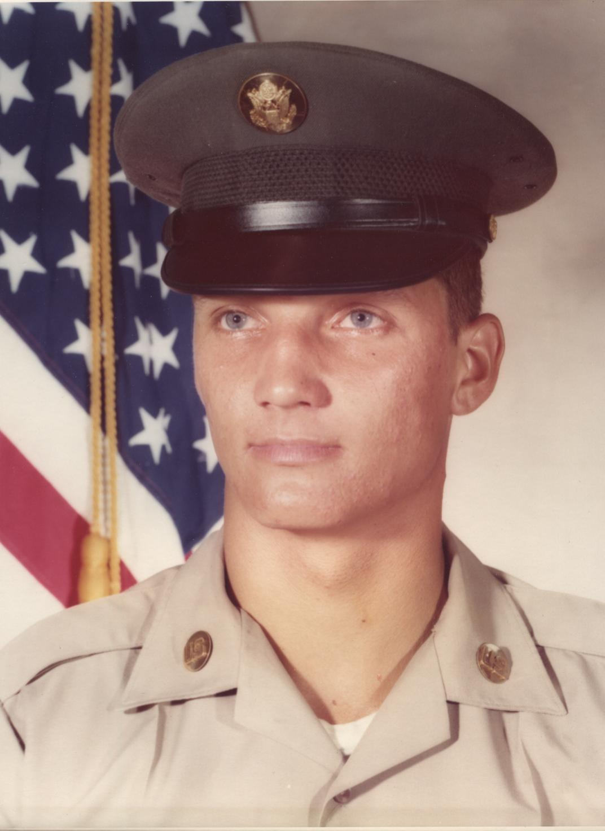
Gary J. Hoefer
Army
1972 - 1975

Slide 27
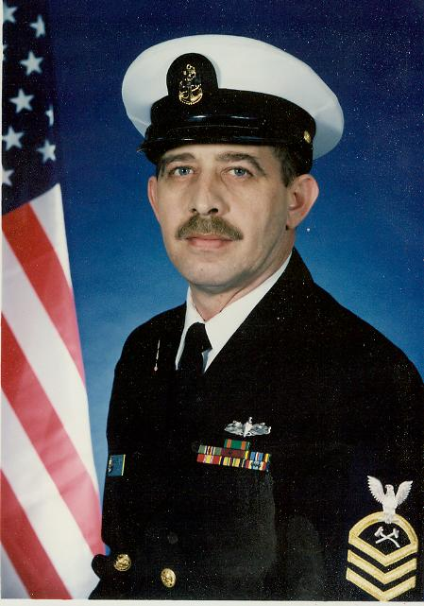
Gaylen Peters
Navy
1974 - 1997

Slide 28
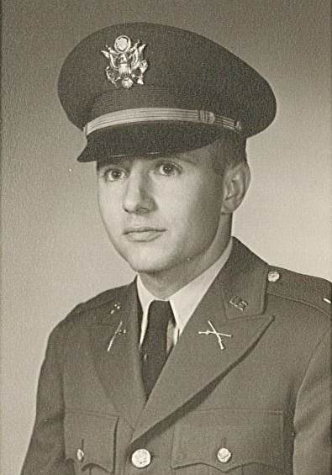
George “Ted”
Rethmeier
Army
1962 - 1968

Slide 29
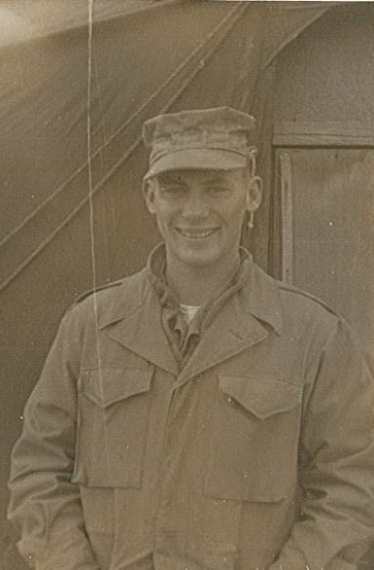
George Sprout
Army
1951 - 1953

Slide 30
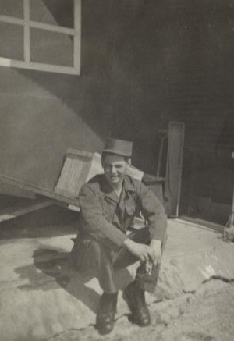
Glen D. Dozler
Army
1953 - 1955

Slide 31
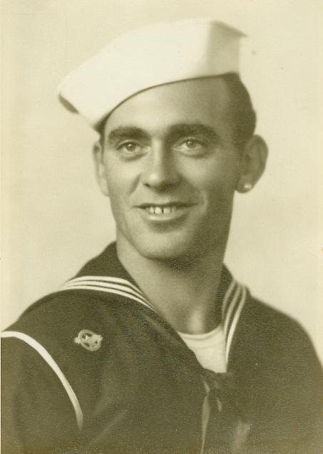
Harold Wayne Tierney
Navy
1945 - 1946

Slide 32
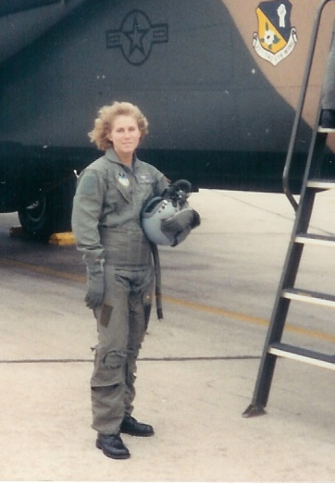
Heidi
Rethmeier
Air Force
1988 - 1997

Slide 33
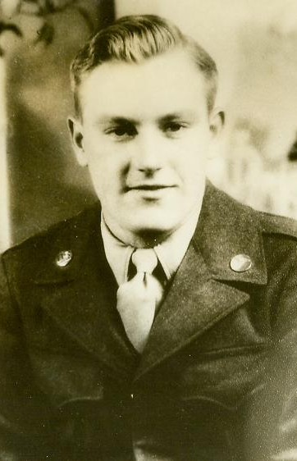
Ivan Kloepper
Army
1945 - 1947

Slide 34
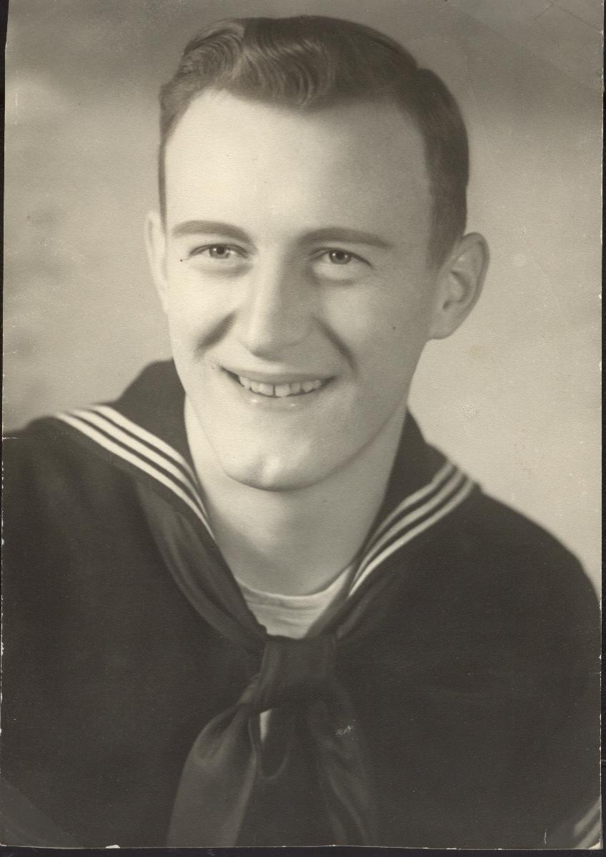
James D. Jochum
Navy
1950 - 1954

Slide 35
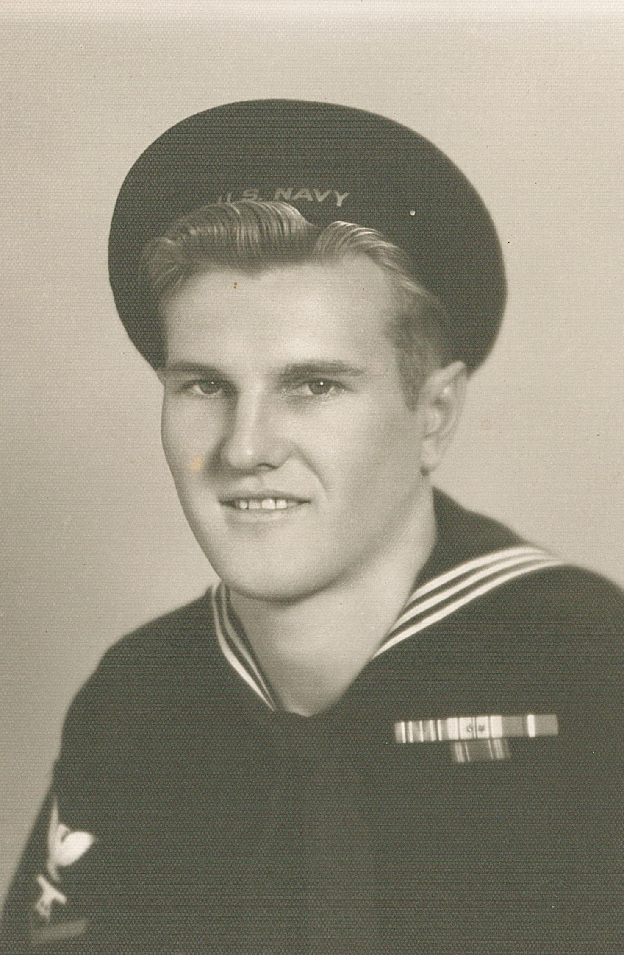
Jerry
Tunink
Navy
1944 - 1966

Slide 36
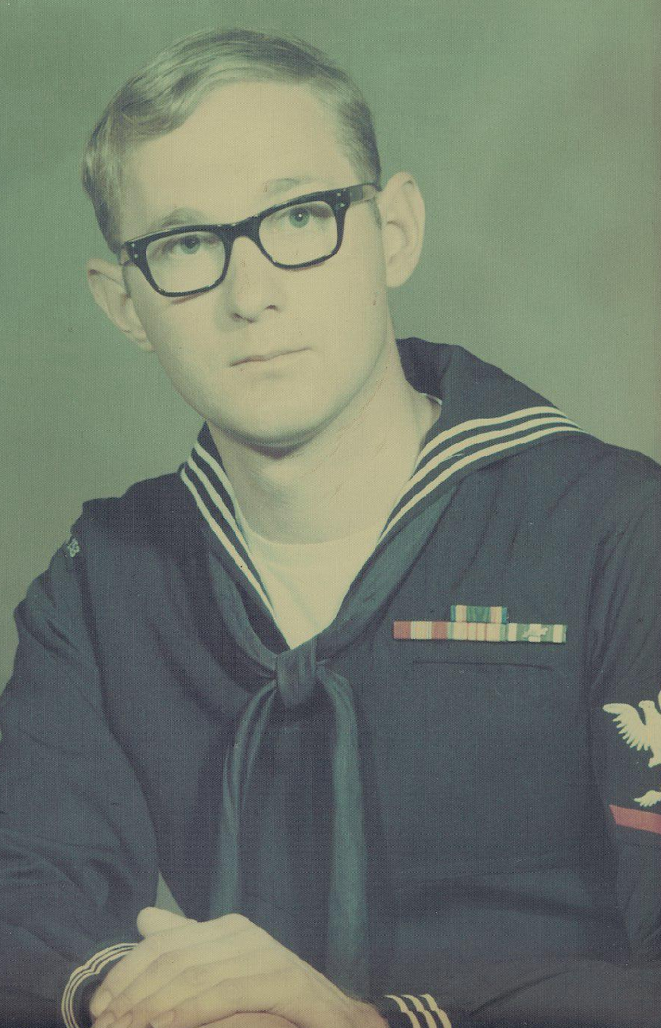
Jim
Getzfred
Navy
1966 - 1970

Slide 37
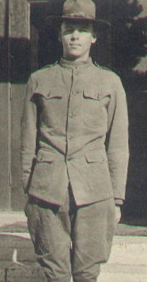
Joe
Swanson
Army
1918 - 1918

Slide 38
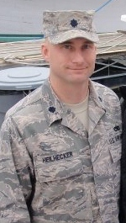
Joseph Heilhecker
Air Force
1988 - present

Slide 39
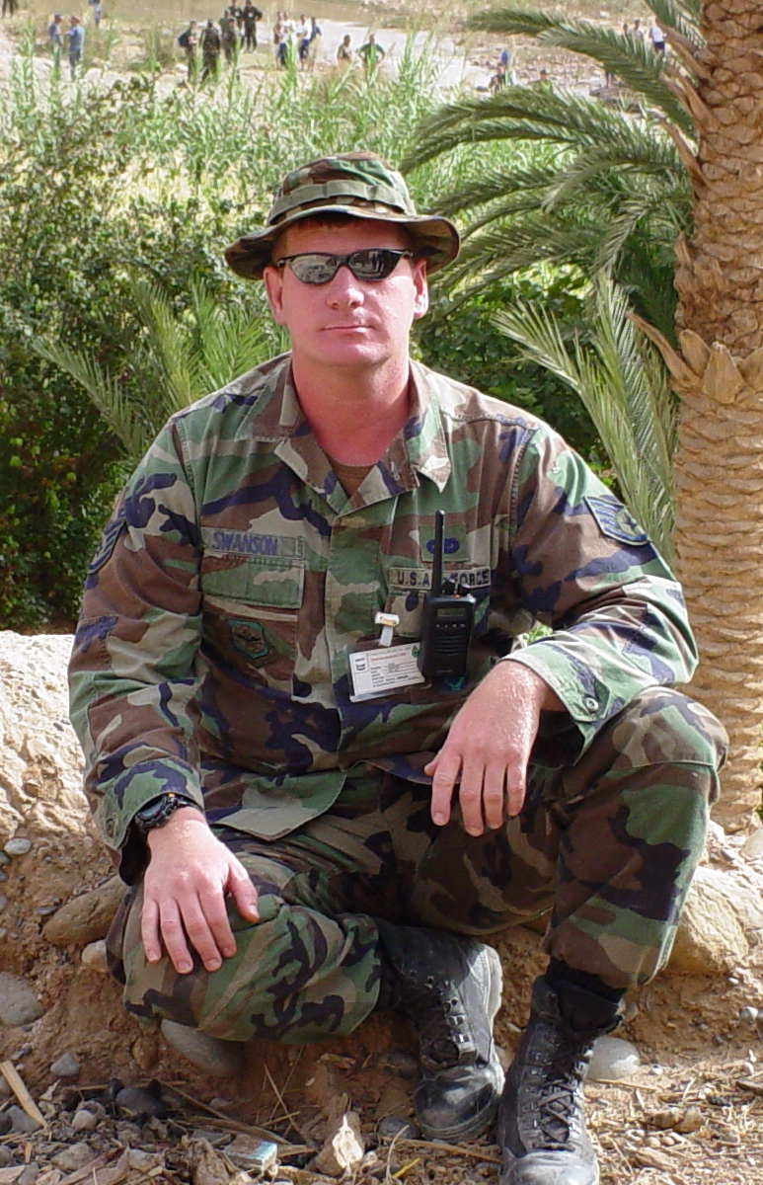
John
Swanson
Marines
1988 – 1992
Reserves & Army National Guard 1992 - present

Slide 40
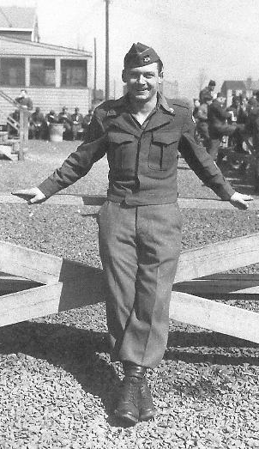
John Buffington
Army
1942 – 1946
1949 - 1953

Slide 41
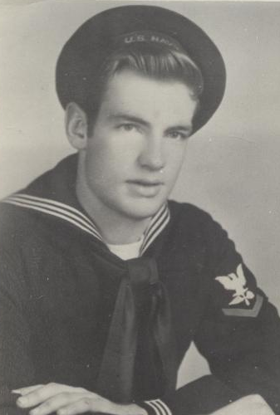
Kenneth D. Bennett
Navy
1941 - 1947

Slide 42
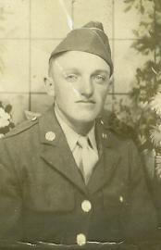
Kenneth Bergstrom
Army
1942 - 1945

Slide 43
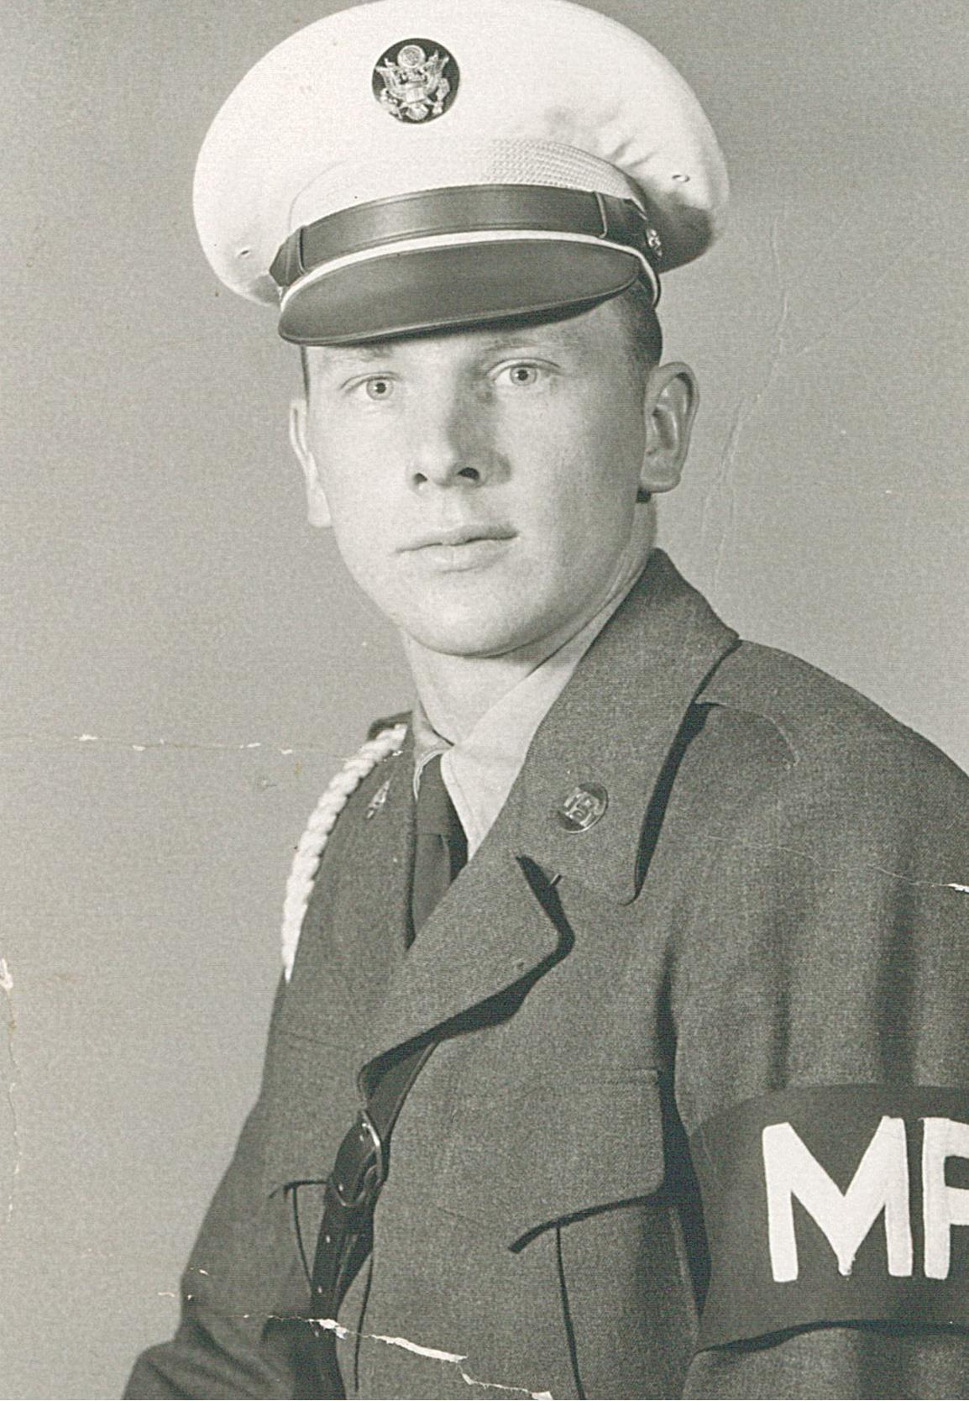
Kenneth Krause
Army
1956 - 1957

Slide 44
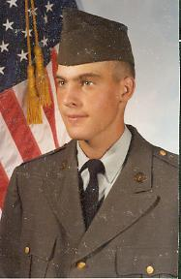
Kenneth Dale Starman
Army
1981 - 1984

Slide 45
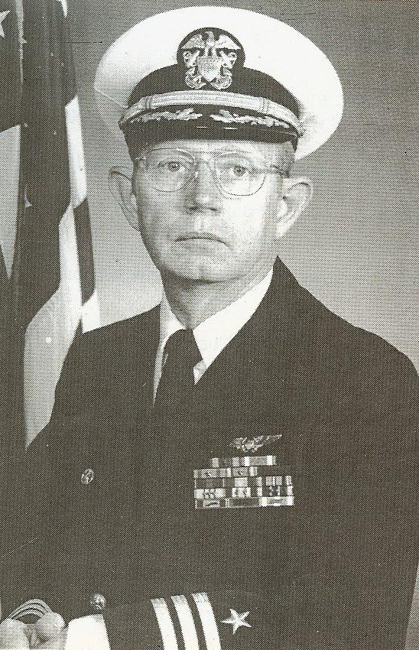
Larry Getzfred
Navy
1963 – 2001
Killed during 9-11-01 attack on Pentagon

Slide 46
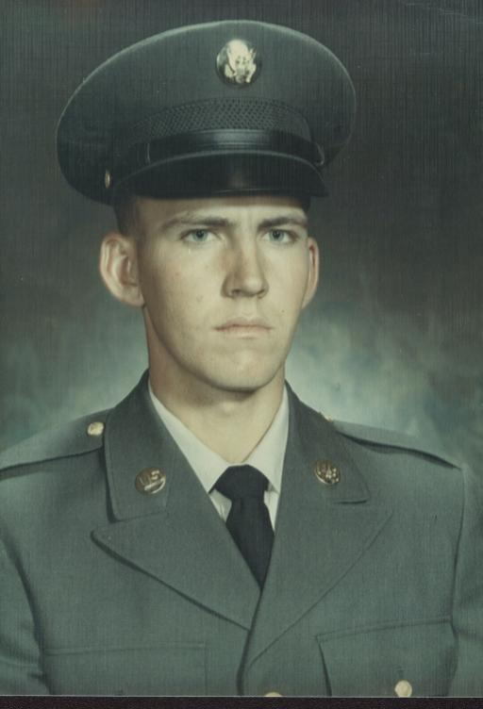
Larry F. Starman
Army
1967 - 1969

Slide 47
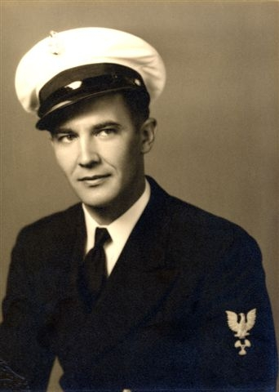
Leland D. Pierce
Navy
1936 - 1946

Slide 48
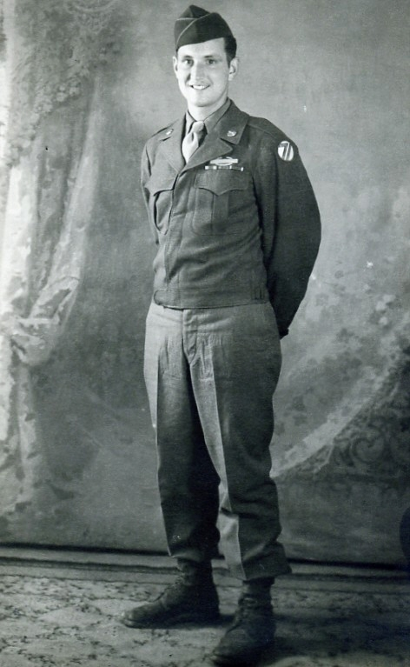
Leland Sprout
Army
1943 - 1946

Slide 49
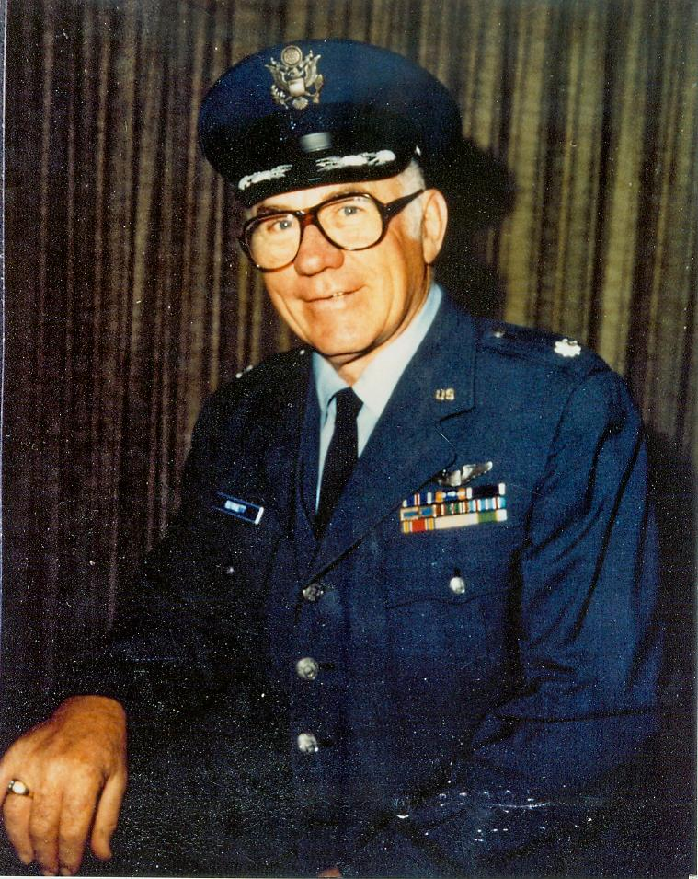
Leonard R. Bennett
Air Force
23 years

Slide 50
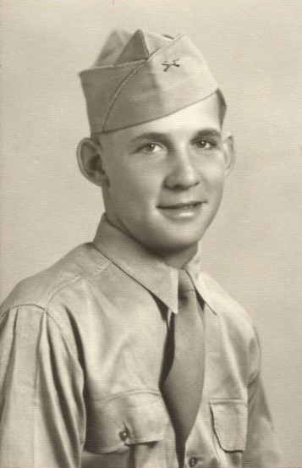
Leonard J. Hoefer
Army
1945 - 1946

Slide 51

Lou Armstrong
Navy

Slide 52

Louis H. Heithoff
Air Force
1951 - 1955

Slide 53

Lyle Dinslage
Army
1953 - 1955

Slide 54

Lyle
Mackel
Navy
1955 - 1957

Slide 55

Martin O. Thorberg
Army
1969 - 1971

Slide 56

Mary Sprout Gallishaw
Air Force
1952 - 1954

Slide 57

Maynard J. Scholl
Army
1952 - 1954

Slide 58

Melvin B. Salber
Army
1952 - 1953

Slide 59

Michael D. Scholl
Marines
2004 – 2006
Killed in Action
in Iraq

Slide 60

Noel Bettendorf
Army
1946 - 1948

Slide 61

Pat
Getzfred
Navy
1980 - 1984

Slide 62

Paul Leathers
Army
1983 - 1995

Slide 63

Paul
Moser
Army
1942 - 1945

Slide 64

Randall Kloepper
Army
1973 - 1980

Slide 65

Raymond Dinslage
Marines
1942 - 1945

Slide 66

Raymond Reestman
Army
1942 - 1945

Slide 67

Raymond J. Schrage
Army
1942 - 1945

Slide 68

Robert D. Hofacker
Army Air Corps
1944 - 1945

Slide 69

Robert Moser
Army
1944 - 1945

Slide 70

Rodney
Mack
Air Force
1984 - 2004

Slide 71

Roland Kinney
Navy
1944 - 1946

Slide 72

Ron Getzfred
Navy
1973 - 1994

Slide 73

Sandra Kloepper White
Air Force
1981 - 1986

Slide 74

Thomas Bauer
Air Force
1977 - 1997

Slide 75

Tony Getzfred
Marines
1988 - 1991

Slide 76

Trenton J. Scholl
NE National Guard
1997 - 2000

Slide 77

Vincent Kallhoff
Army
1962 - 1965

Slide 78

Virgil Lawson
Navy
1918 - 1919

Slide 79

Walter F. Schrage
Army
1951 - 1953

Slide 80

Warren Siems
Army
1952 - 1954

Slide 81

Wayne Currie
Army
1942 - 1945

Slide 82

Wayne Swanson
Marines
1959 - 1962

Slide 83

Wilfred Arehart
Army
1944 - 1946

Slide 84

William Sprout
Army
1952 - 1953

Slide 85

Thank You,
Veterans!

