Slide 1
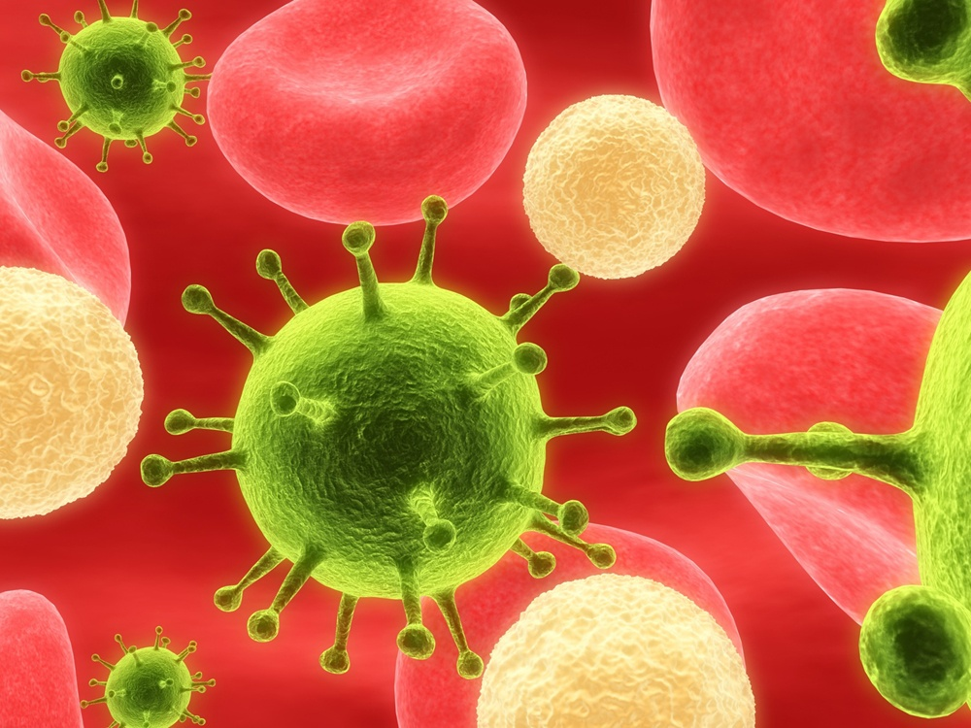
Viruses
By
Brett Kinney and Faith Breaker

Slide 2
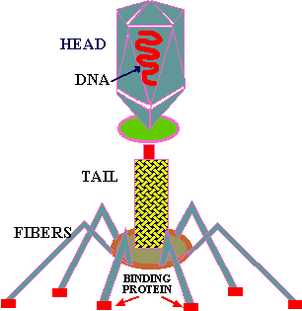
The appearance of viruses
A virus has two parts a head and a tail
The head has two parts a Hereditary material, which controls the production, and an outer coat of protein
The protein coat encloses and protects the virus

Slide 3
Types of viruses
Smallpox
Aids
Influenza
Bacteriophage
Tobacco mosaic
Yellow fever
Poliomyelitis
Escherichia coli bacterium

Slide 4
Functions of viruses
Are tiny particles
All cells are subject to invasion by some kind of cells
Cannot perform all function of living cells like taking in food and getting ride of wastes
Can’t reproduce on their own
Viruses can only invade a few specific kinds of cells

Slide 5
Reproduction
The virus attacks the bacterium
It than injects hereditary material in to the Bacterium
Its hereditary material takes control of the bacterium causing the virus parts to be made
Viruses are then made
The bacterium bursts releasing the viruses

Slide 6
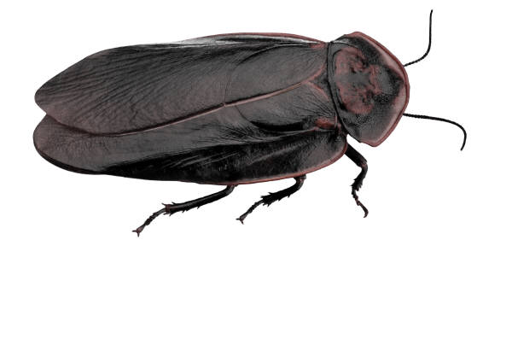
Harmful and beneficial Applications
Harmful
Cause a large number of diseases that can cause serious damage or even death
Helpful
Are helpful if we have a pest problem

Slide 7

Locations
In a body with cells

Slide 8
The
End

